Slide 1

Meeting for Parents

Slide 2
Senior Leadership Team
Ms. Natalie Saliba (Head of School)
Mr Antonio Caruana (kinder)
Ms Iren Mizzi (Year 1, Year 2)
Mr Randolph Peresso (Year 3, Year 4)
Ms Sandra Abela (Year 5, Year 6)
Ms Marygrace Giordmaina (SEN)

Slide 3

Number of Classes
Kinder 1 – 8 classes
Kinder 2 – 5 classes
Year 1 – 4 classes
Year 2 – 3 classes
Year 3 – 4 classes
Year 4 – 3 classes
Year 5 – 4 classes
Year 6 – 4 classes

Slide 4
First Day of School
27 Sep.
Primary students
2 Oct.
Kinder 2 students
3 Oct. and 4 Oct.
Kinder 1 students – 3rd and 4th October (by appointment)

Slide 5
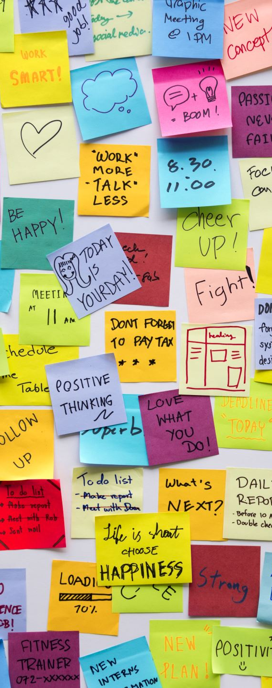
Admission and Dismissal
Admission timetable will be uploaded on the school website.
Dismissal timetable will be uploaded on the school website.
Admission and dismissal will be staggered.
Punctuality is of utmost importance.
Students who walk back home on their own need to have a note signed by the parents and given to their respective teachers on the first day of school.

Slide 6

Calendar
The scholastic year calendar has been uploaded on the school website.
Calendar may be amended.
Other national, college, school and class activities may be organised throughout the scholastic year.
Please log on to the school website (siggiewiprimary.wordpress.com) regularly, for further details and updates.

Slide 7
Online meetings with Educators
28th September – Yr 6 at 9.00
Yr 5 at 11.00
Yr 4 at 13.00
29th September – Year 3 at 9.00
Year 2 at 11.00
Year 1 at 13.00
27th September - Kinder 1.1- 1.4 at 10.00
Kinder 1.5 - 1.8 at 11.00
Kinder 2 at 13.00

Slide 8
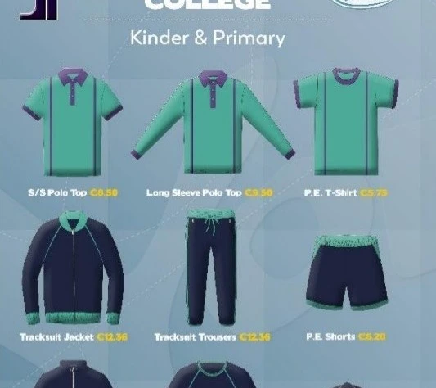
School Uniform – New uniform
White running shoes with matching white socks.
Dark blue jacket if uniform jacket is not available.

Slide 9

Communication with Educators
MS Teams
Email
Class Dojo
Telephone (25987630)

Slide 10
Homework
Check that homework is complete.
If homework is difficult, get in contact with the class teacher.
Correction of homework must be done for learning to take place.
Children should read for enjoyment everyday.
Studying must be continuous.

Slide 11
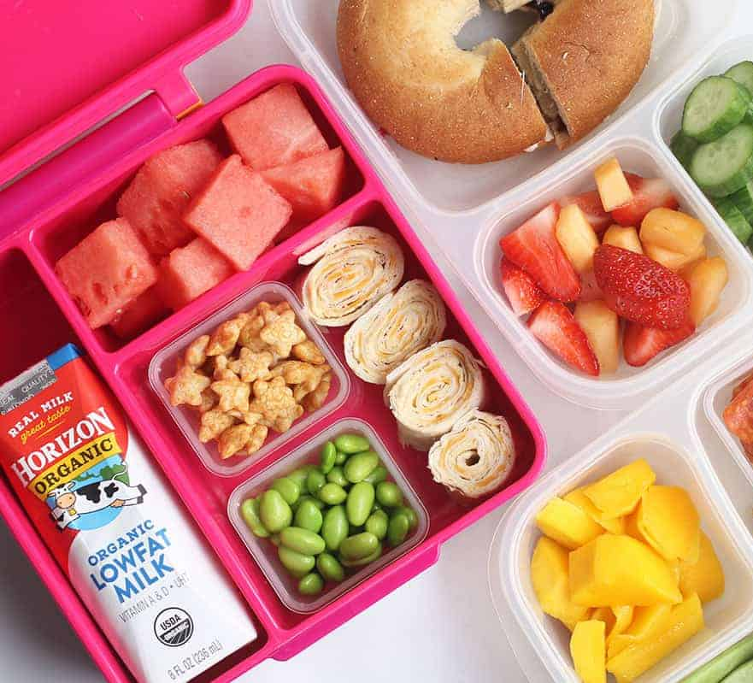
Lunch
Any healthy food : bread, pasta, rice, salad, fruit…..
A bottle of water
No sweets, chocolates, soft drinks… are permitted.
Cakes (for class only) are only permitted on birthdays.
Educators must be notified of any child who suffers from any kind of allergy.

Slide 12
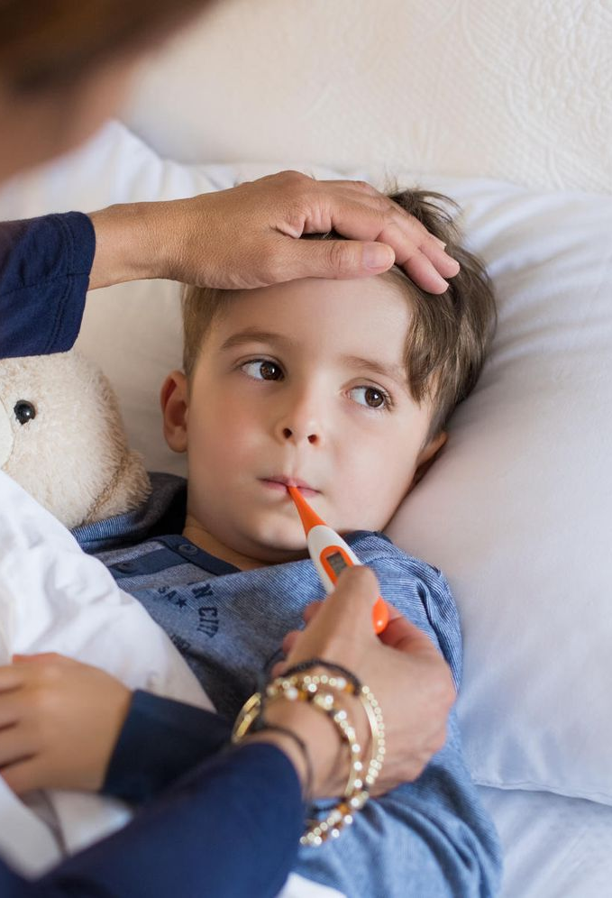
Sick
Children absent from school, must present a medical certificate on the third day.
Children can only be excused for two days and upon presentation of a note signed by the parents.
No HW will be given to children who are sick.
Children who go abroad on holiday will be marked as absent.

Slide 13

School Council
Dr Ruth Falzon – President
Ms N Saliba - HoS
Ms Melanie Bonello – Educator
Ms Charmaine Galea – Educator
Ms Kathianne Farrugia - Educator
Ms Vanessa Farrugia – Parent
Ms Karen Agius – Parent
Ms Kirsten Zammit - Parent

Slide 14

Thank you

