Slide 1
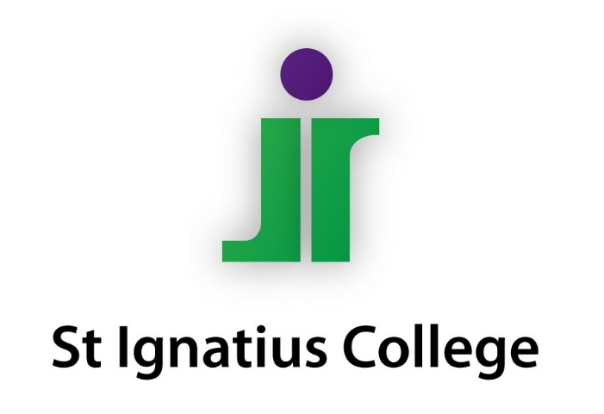

Welcome to
Siġġiewi Primary School

Slide 2

First day of school
Kindergarten 2
Monday 2nd October 2023
Kindergarten 1
First day of school by
appointment (received by
post):Tuesday 3rd &
Wednesday 4th October 2023
Kindergarten 1 – first 5 days of school till 12:00pm
Make the first day of school a positive one, reassure your child you will pick him/her up after school.

Slide 3
First week of school
Admission and Dismissal Timetable can be found on school website.
Breakfast Club can be used by Kindergarten 2 from the first day of school.
Breakfast Club can be used by Kindergarten 1 from the second day of school.
Klabb 3-16 (after school hours can be used once children are attending for a full day (till 2.30pm)
It will help us, if children are to wear a name tag during their first days at school.

Slide 4
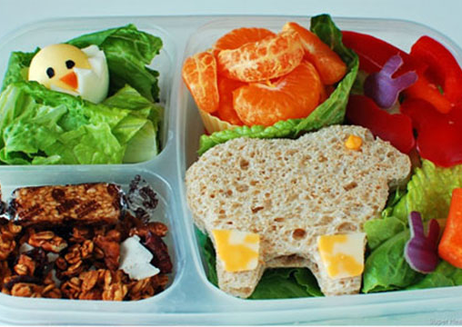
Lunches
Healthy eating policy.
Easy to open lunchboxes.
Food they can eat independently.
You will be informed if any learners in your child’s class have a food allergy.

Slide 5

Self-help routines
Child has to be :
toilet trained
able to wash hands with soap independently
able to dress and undress independently
It is important to label all clothing items.

Slide 6
Language and Literacy
Development of phonological awareness.
Development of auditory sequential memory.
Development of visual sequential memory.
Emergent literacy.
Shared reading.

Slide 7
Mathematics
Number recognition and value.
Recognition of shapes.
Measurement.
Sequencing.
Patterning.

Slide 8
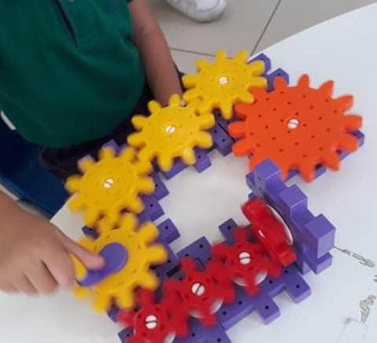
Science and Technology
Labelling.
Identifying.
Sorting.
Predicting.
Comparing.
Grouping.
Use of technology.

Slide 9
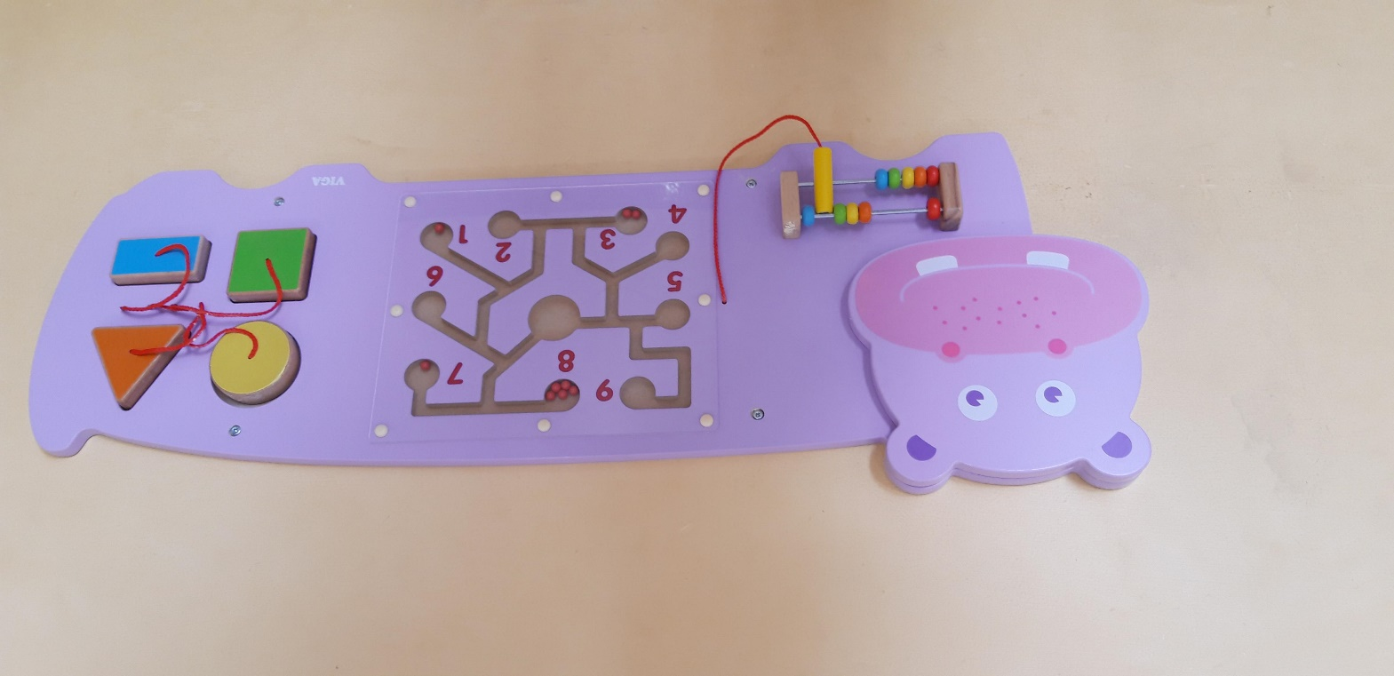
Physical Development
Yard.
Playroom.
Various activities in class.
Kidlympics.

Slide 10

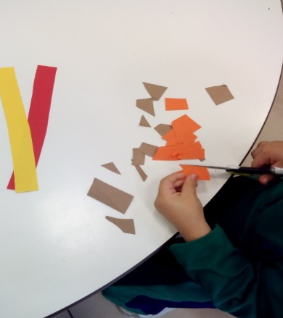
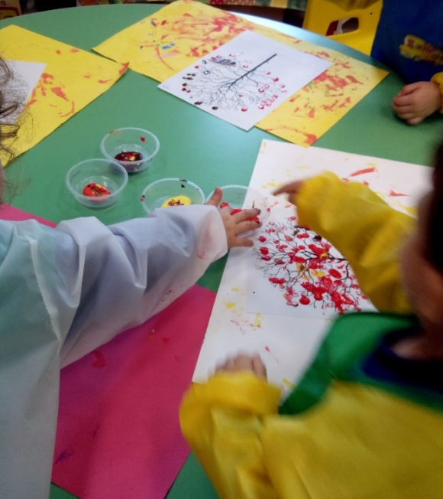
Crafts
Using different materials.
Developing fine-motor skills.

Slide 11

Communicating
Next week parents’ meetings with class KGE will be held online through MsTeams (see school website for details).
Each child has an ilearn account and password. (Parents who do not yet have access to their child’s account will receive the link through their personal email address.)
This account will be used to communicate with the class KGE.
Register on school website: siggiewiprimary.wordpress.com

Slide 12
Working together
Children enter kindergarten with different backgrounds, language, experiences and stages of development.
All children need support and we will be working together to support your child at school.
Early identification, early support, early intervention.

Slide 13
Thank You
Anthony Caruana (Assistant Head of School)
antonio.caruana@ilearn.edu.mt

