Slide 1
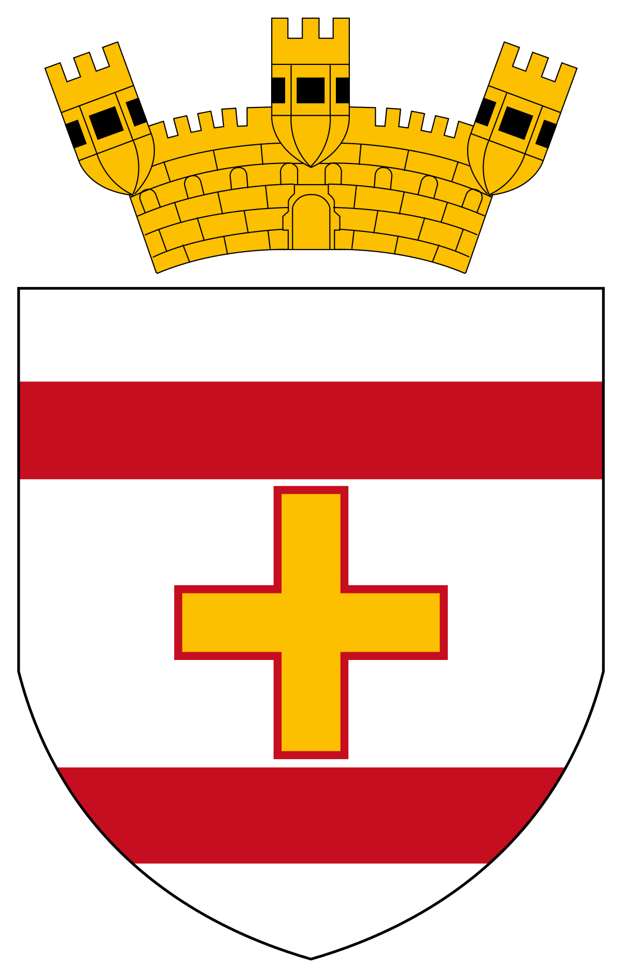

Siggiewi Primary School Malta
Year 6.4

Slide 2
Layout of this Presentation:
The class of 6.4 prepared some information about our:
  Class
  School
  City
  Country
The children themselves chose the task they would like to work on, and did their own research to find information about the task they chose.

Slide 3
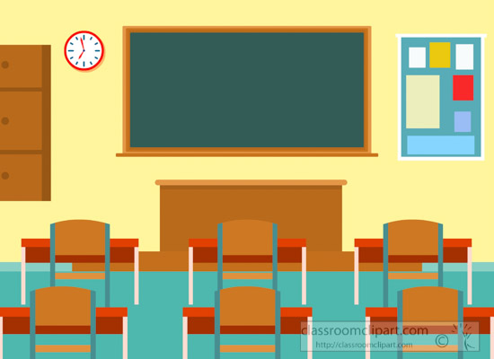

Year 6.4
We are a class of 19 children, together with 2 learning support educators and our class teacher.
In class we learn Maths, English, Maltese, Social Studies, Religion, Science and Art. We do Kahoot activities, crafts, drawing and use our mini-whiteboards for sums.

Slide 4
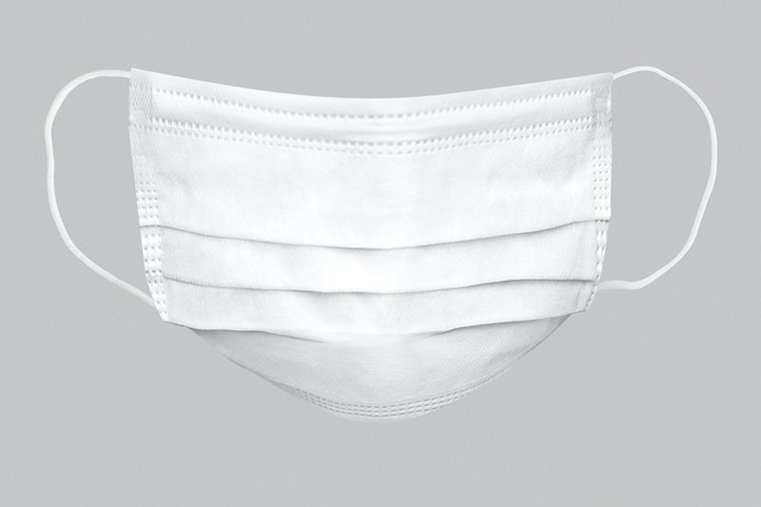
Life in class is a normal day for us where we learn and make the best out of it every year. In class we make friends and learn new things you never knew before.
Usually our desks are grouped together but this year they are separated because of the pandemic.
Now that this pandemic started, life in class is a bit different as we must wear a mask, clean our hands very often and keep a two meter distance. How is life in school for you now? ☺ Hope everything is fine ☺

Slide 5
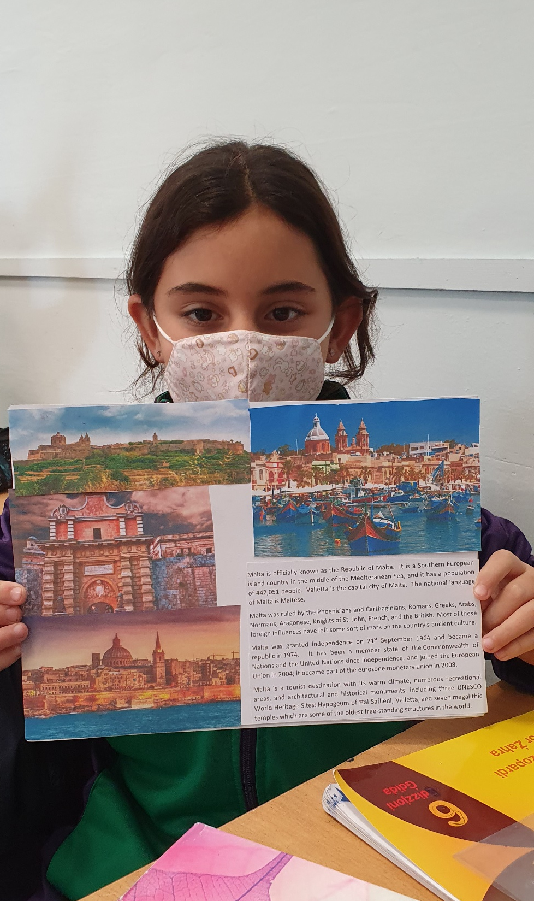
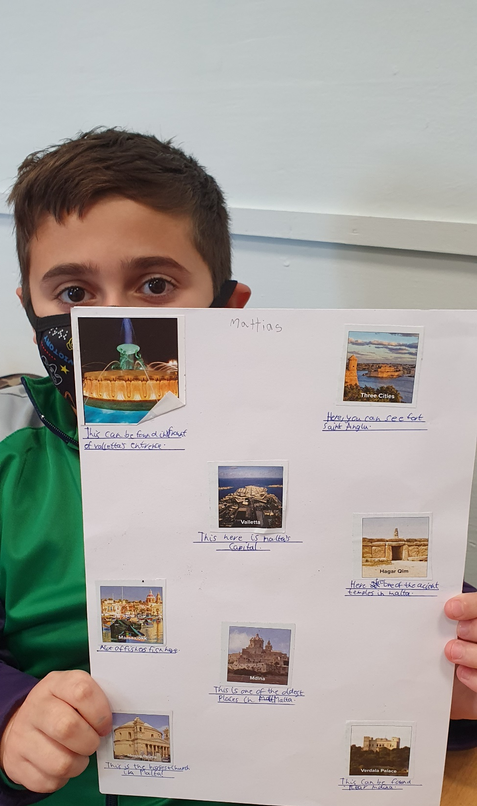
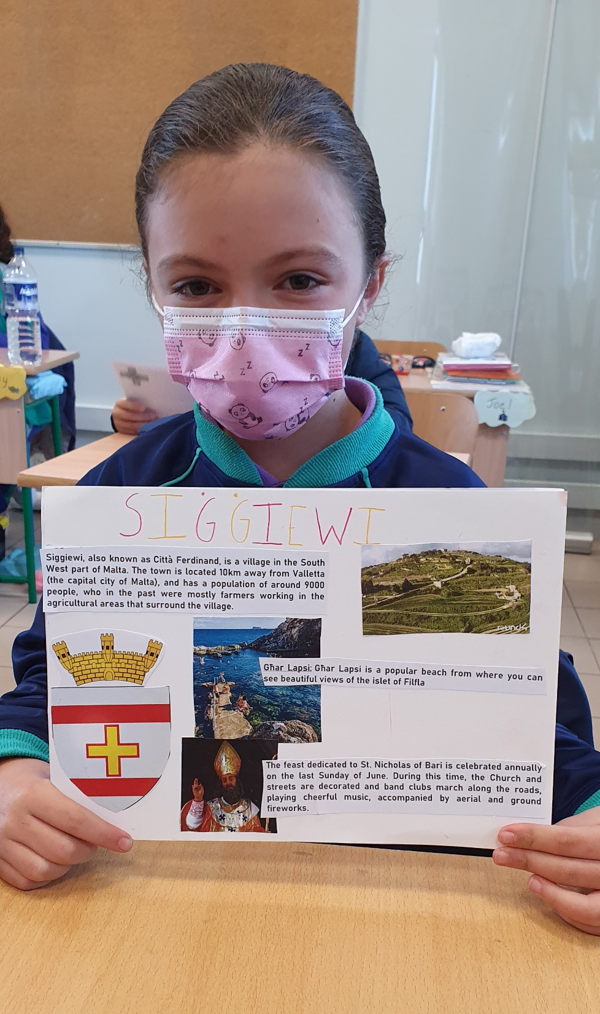

Slide 6
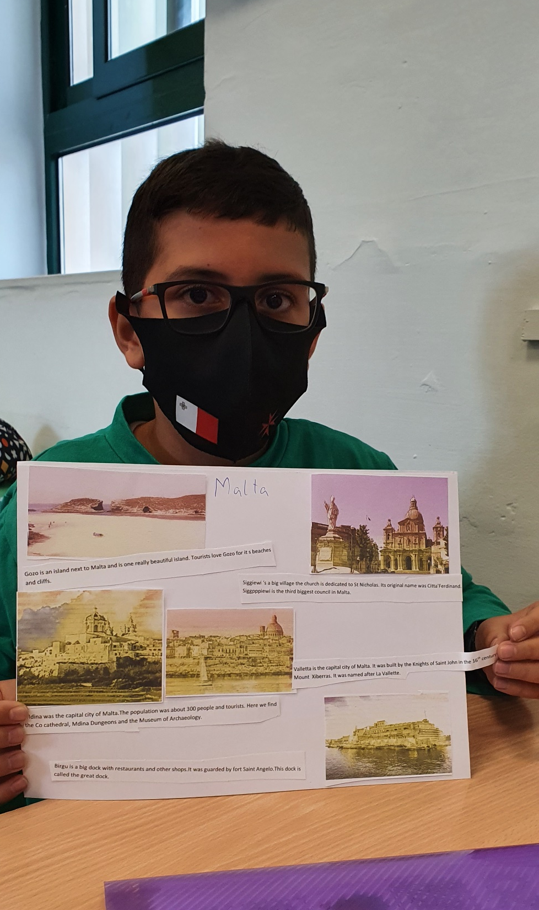
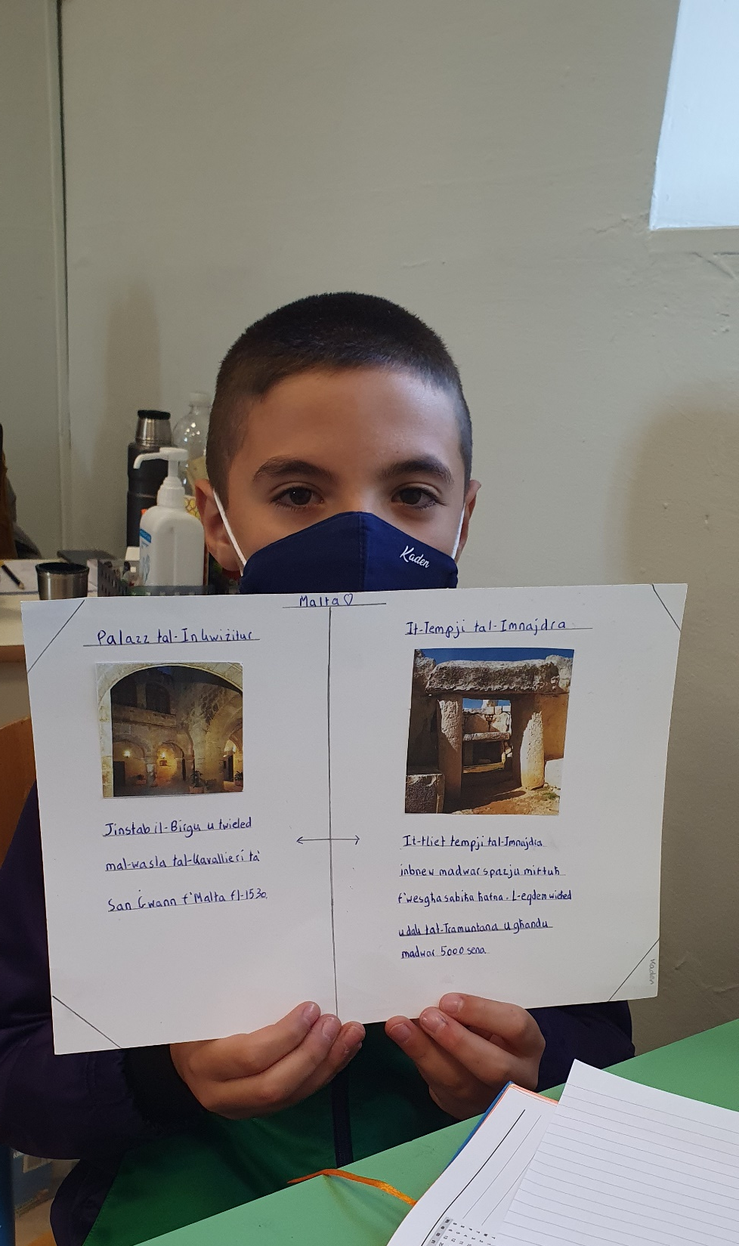
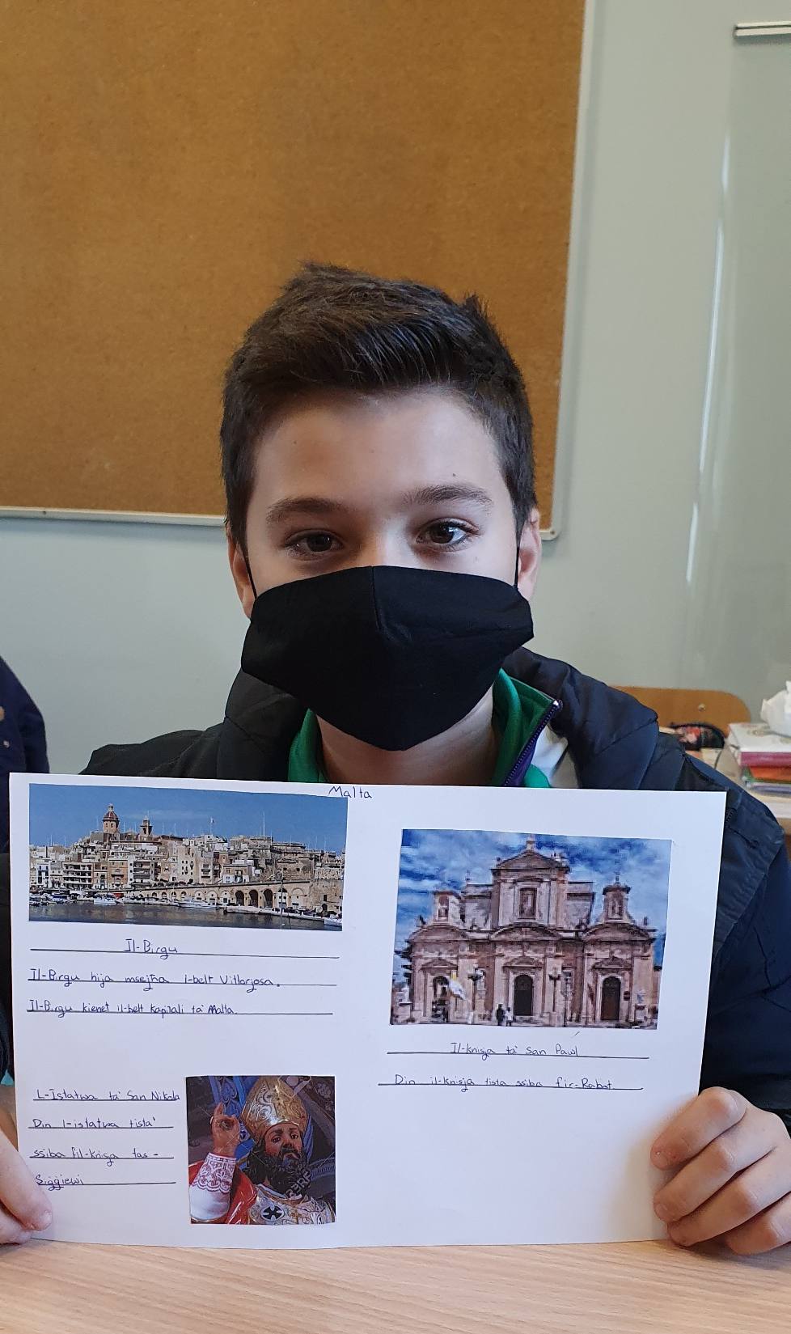

Slide 7
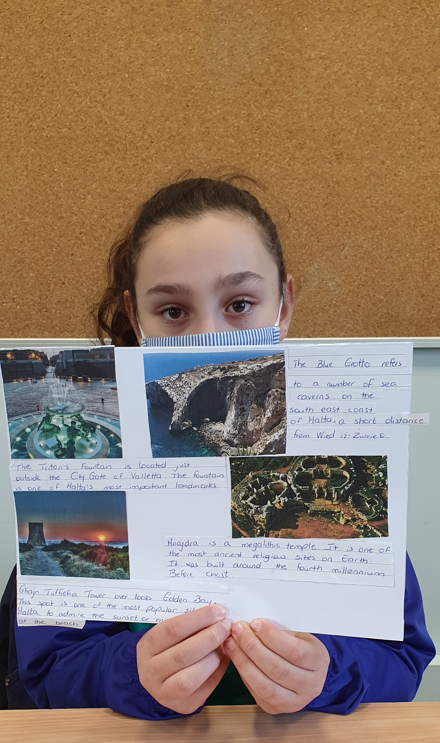
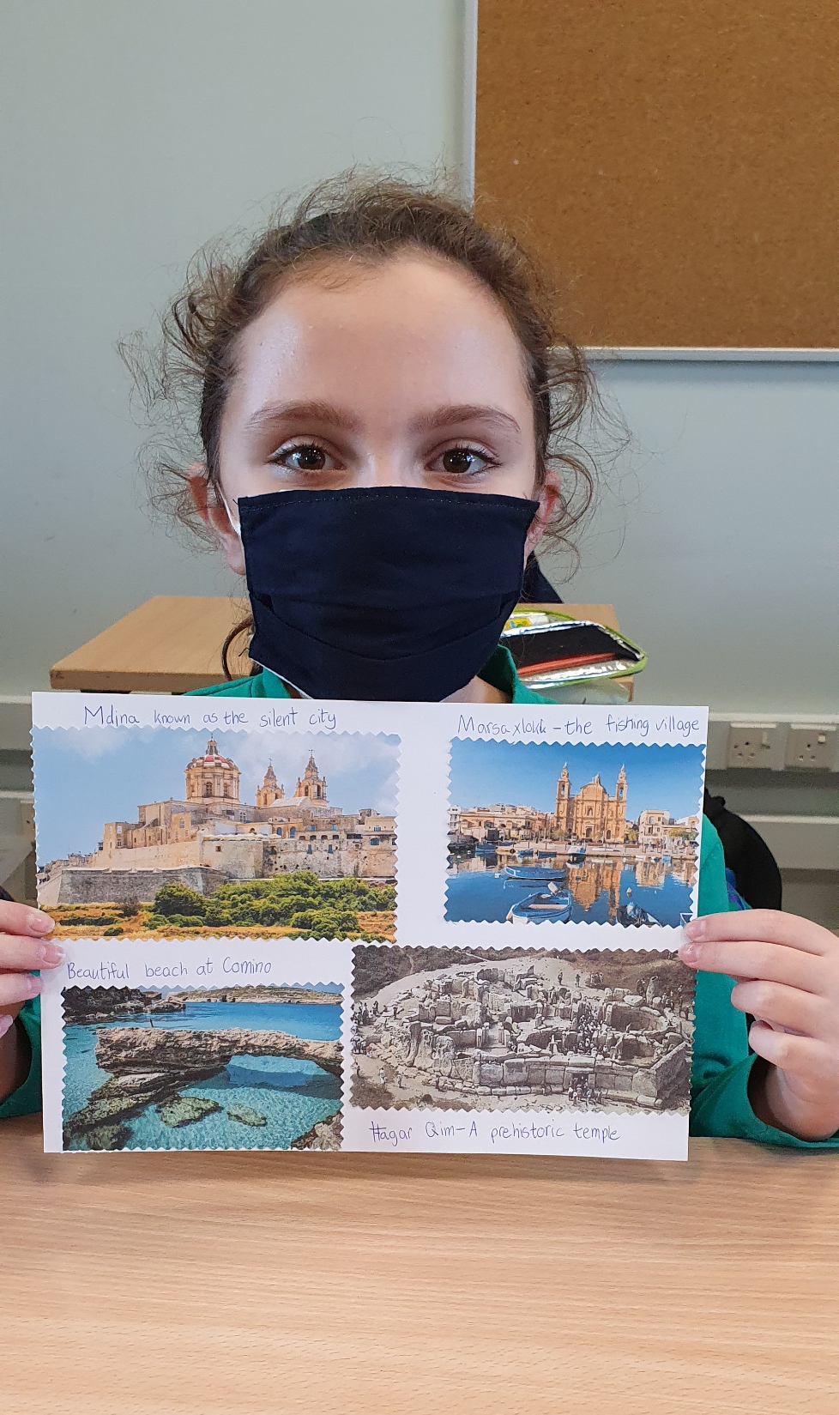
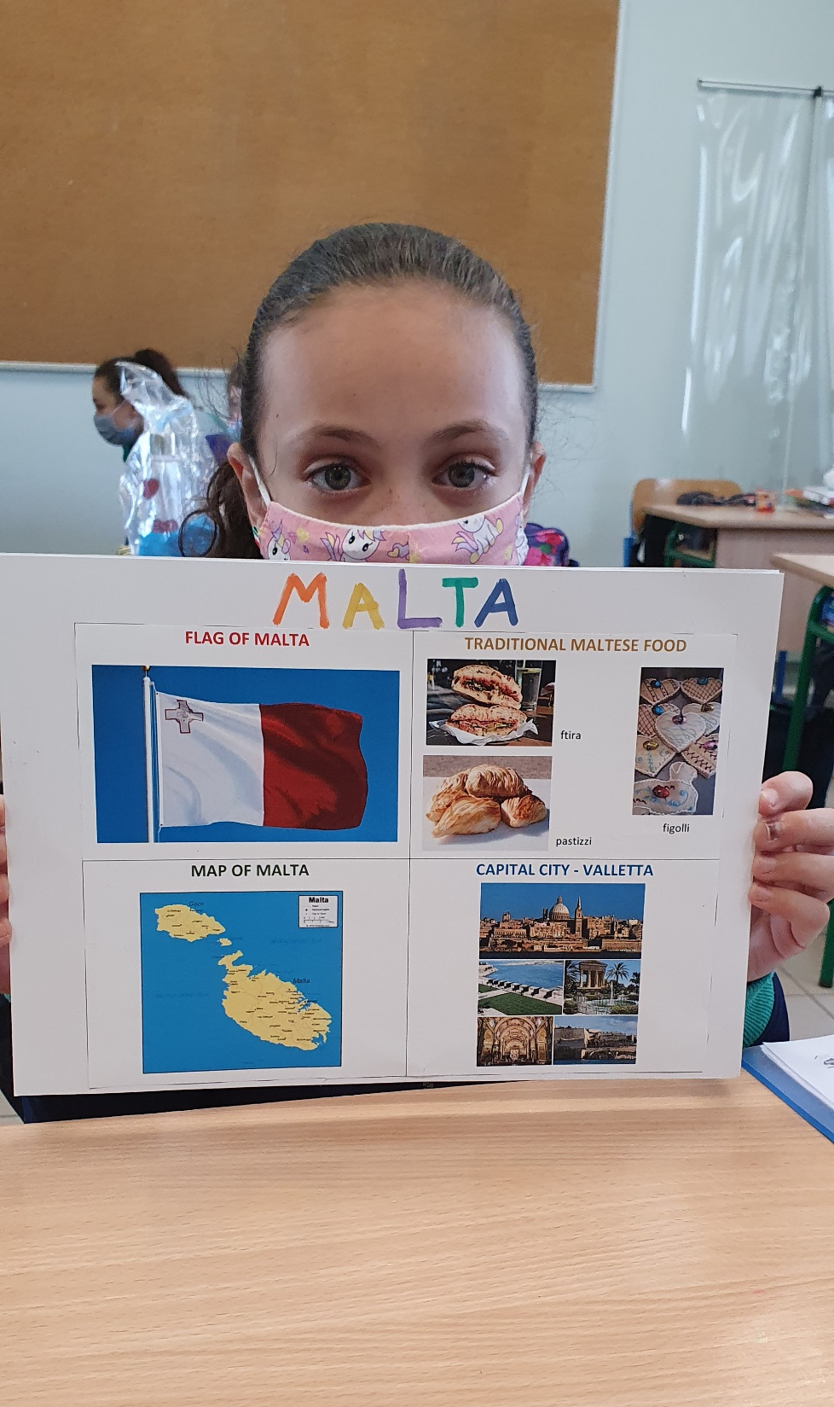

Slide 8
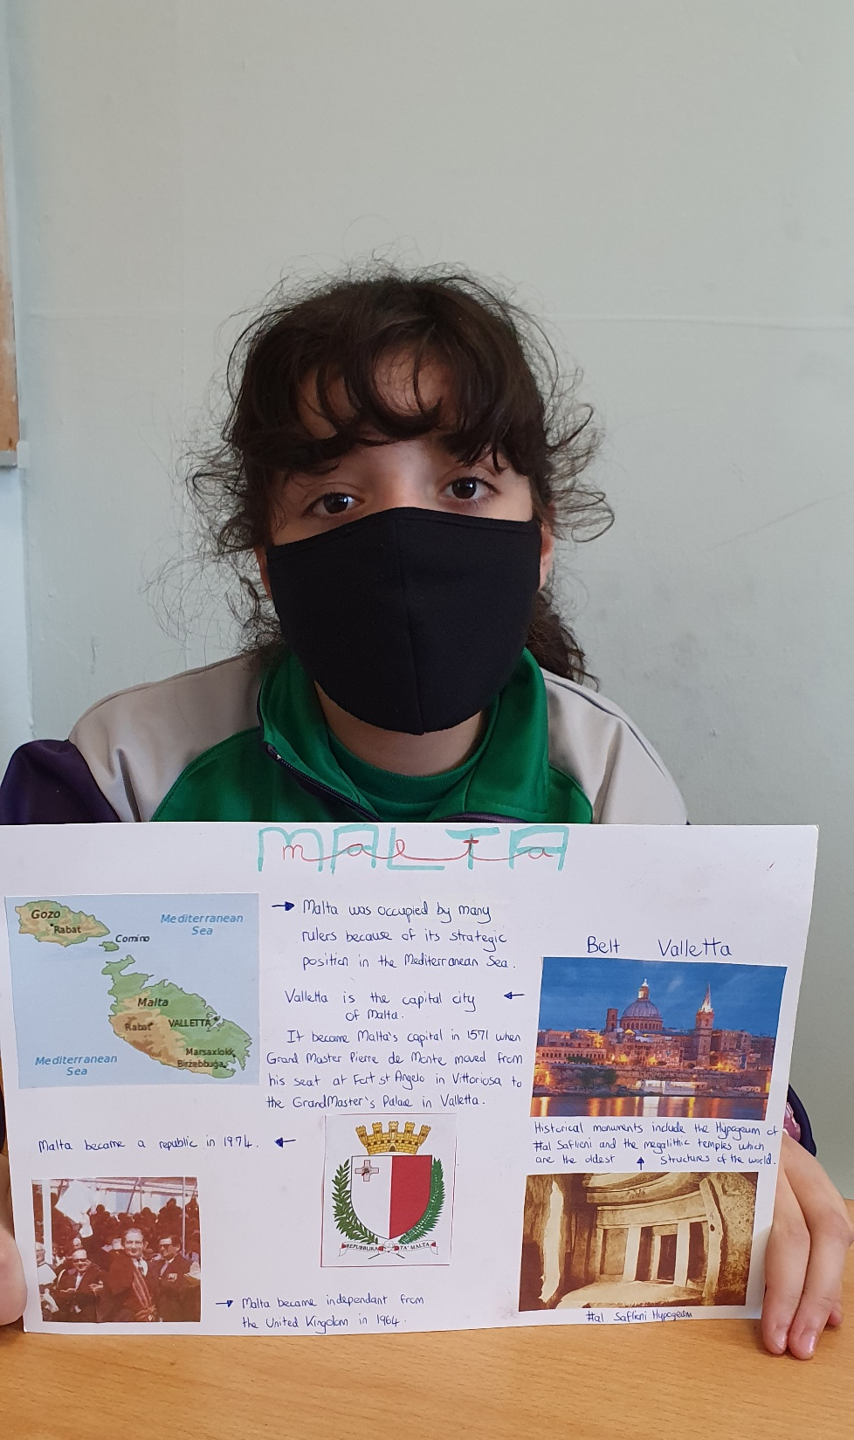
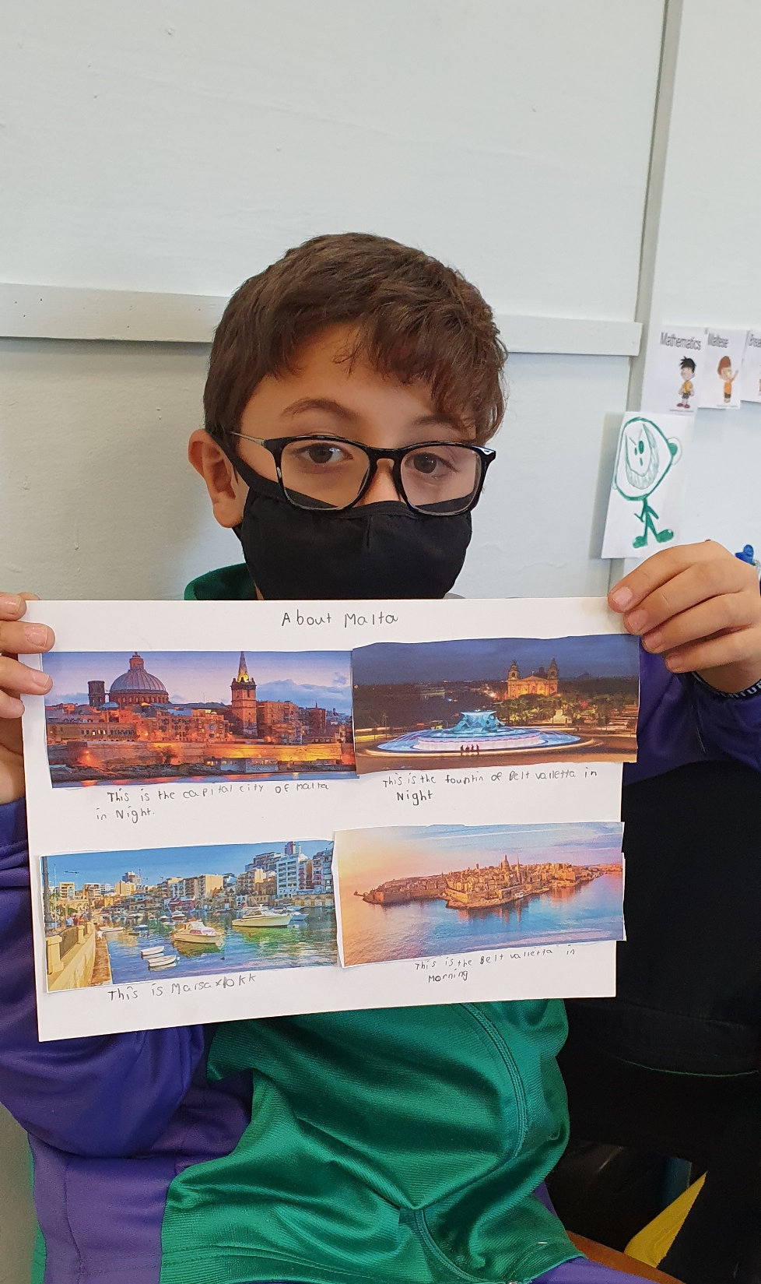
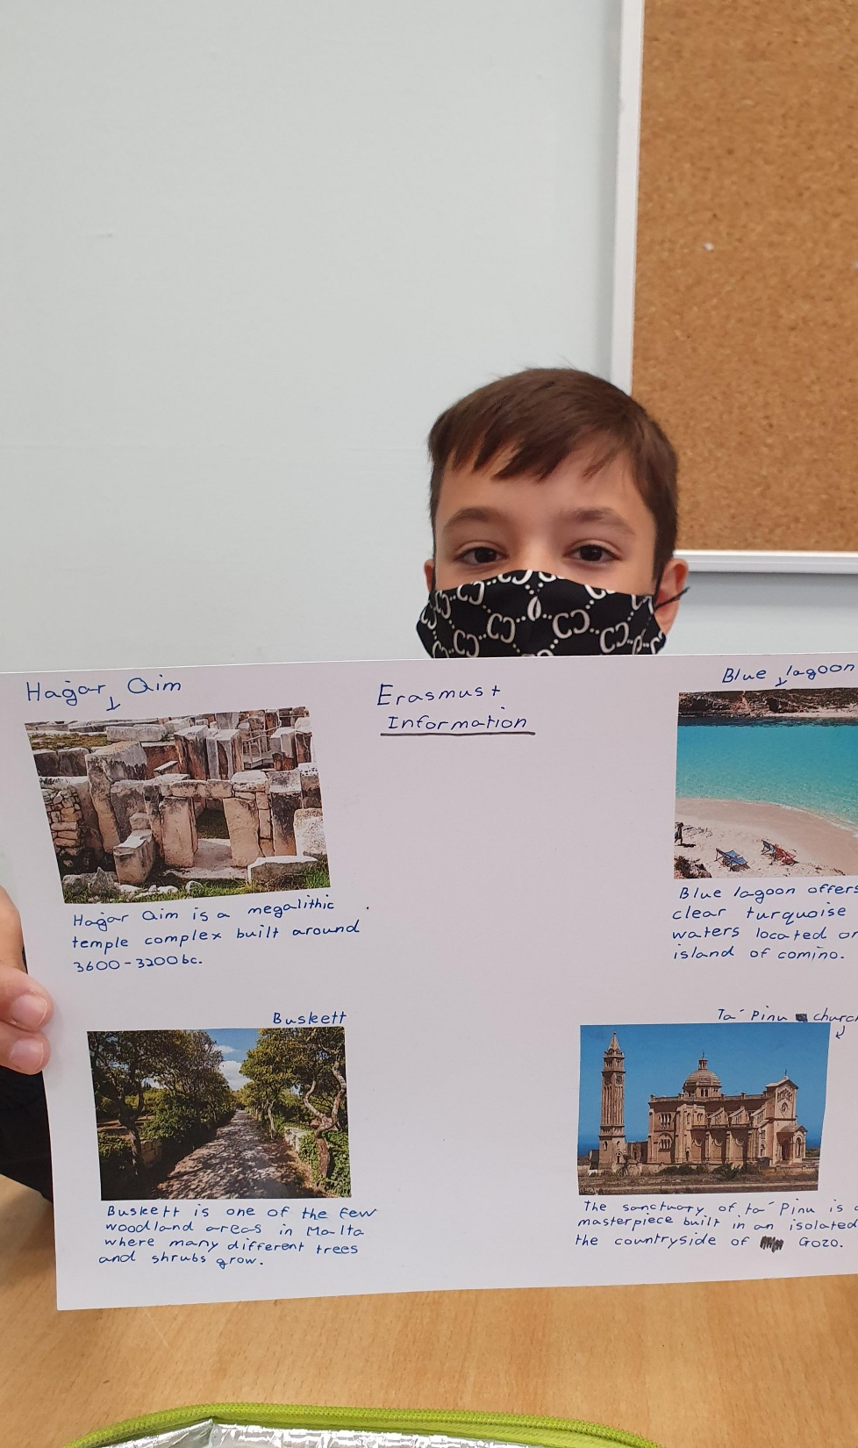

Slide 9
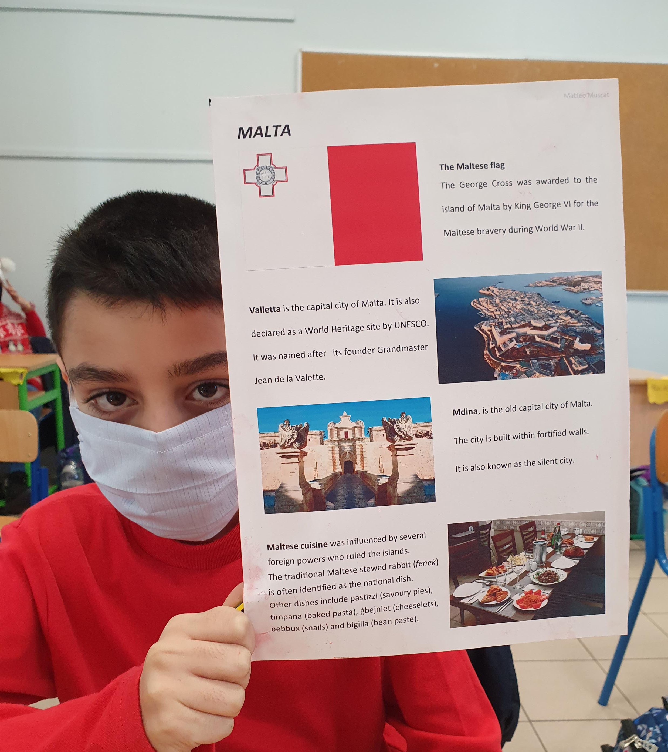
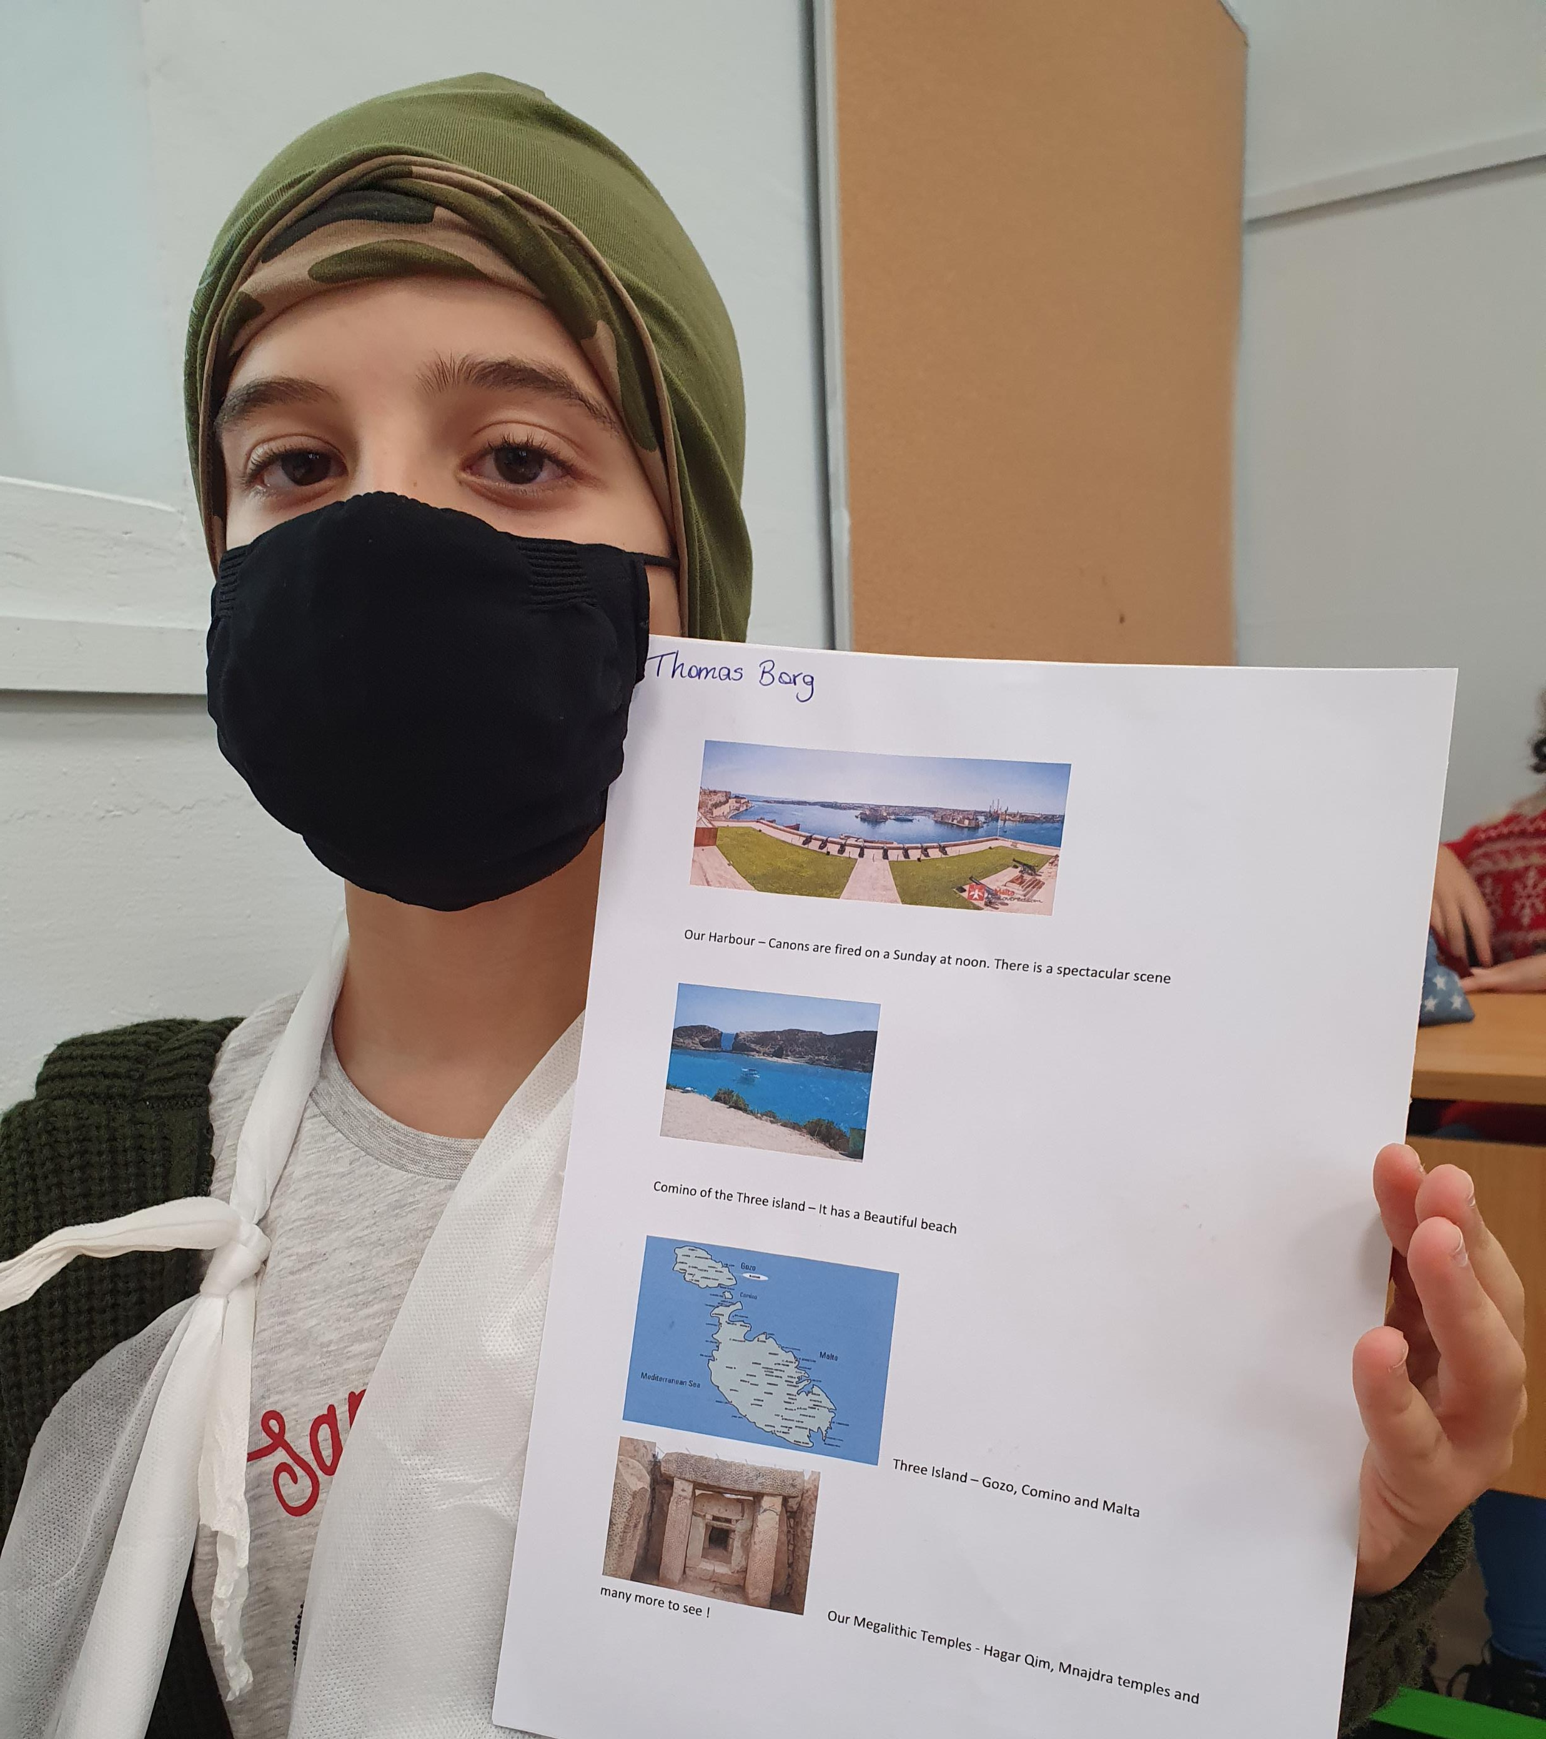

Slide 10
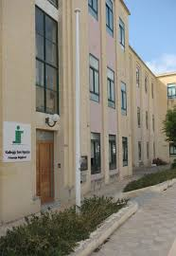
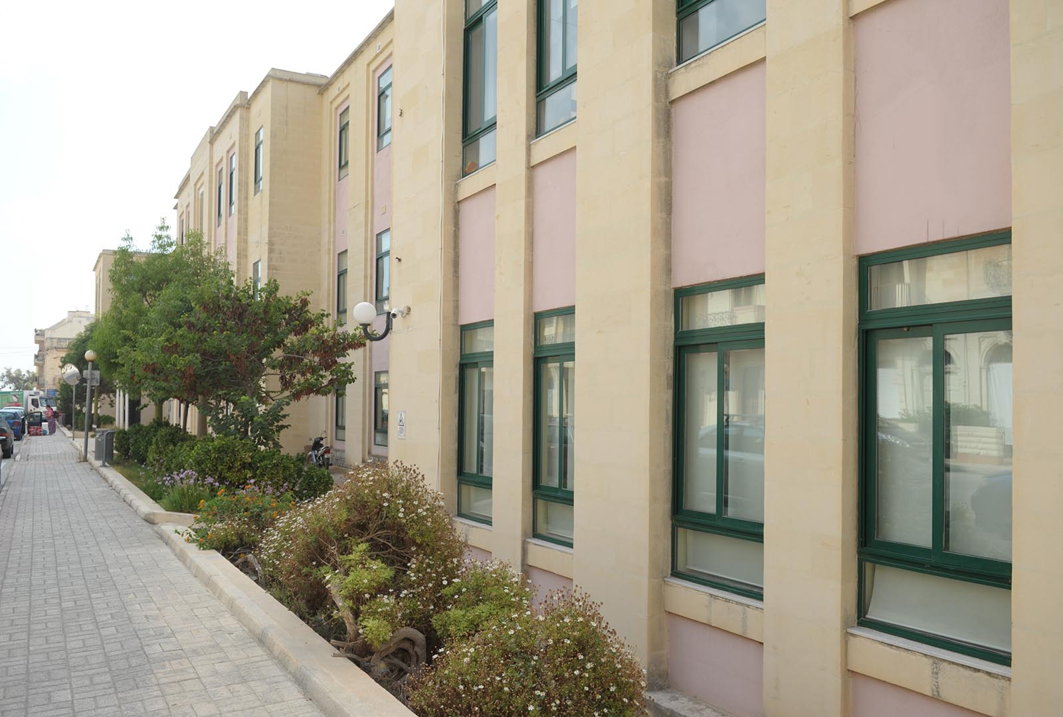
We attend St Ignatius College Siġġiewi Primary School. The school is very modern.

Slide 11
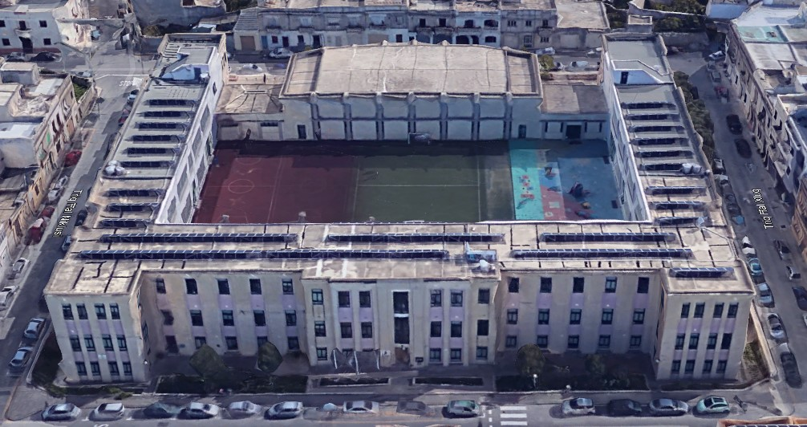
St. Ignatius College – Siggiewi Primary School
Our school was originally inaugurated in 1951.

Slide 12
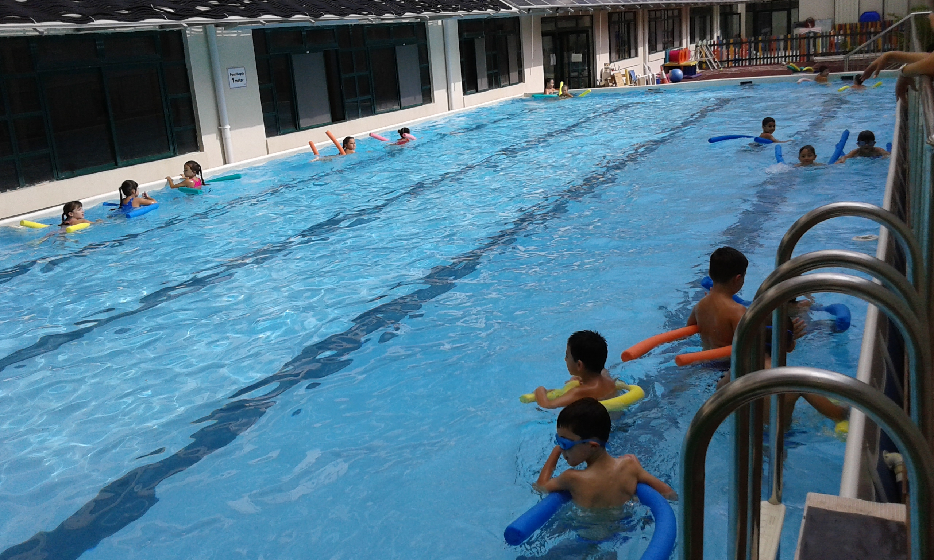
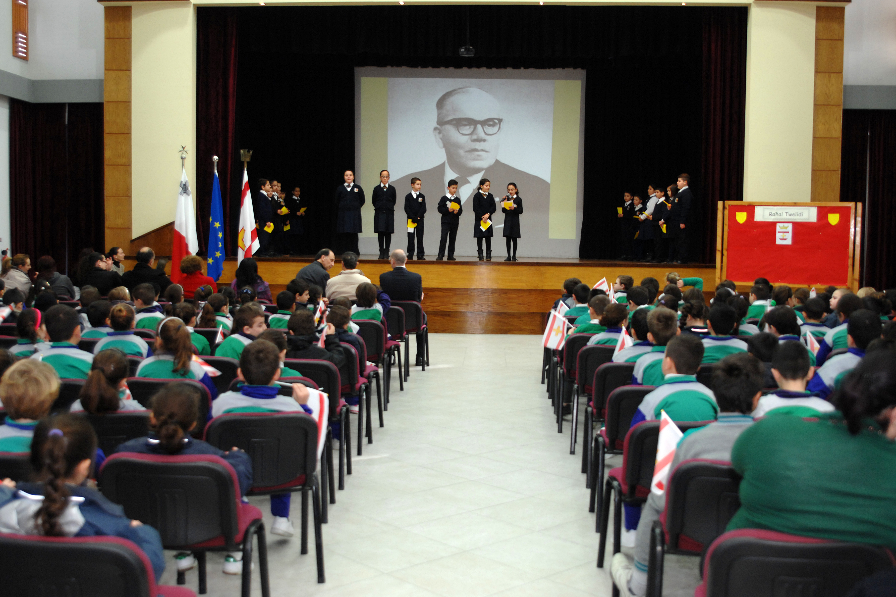
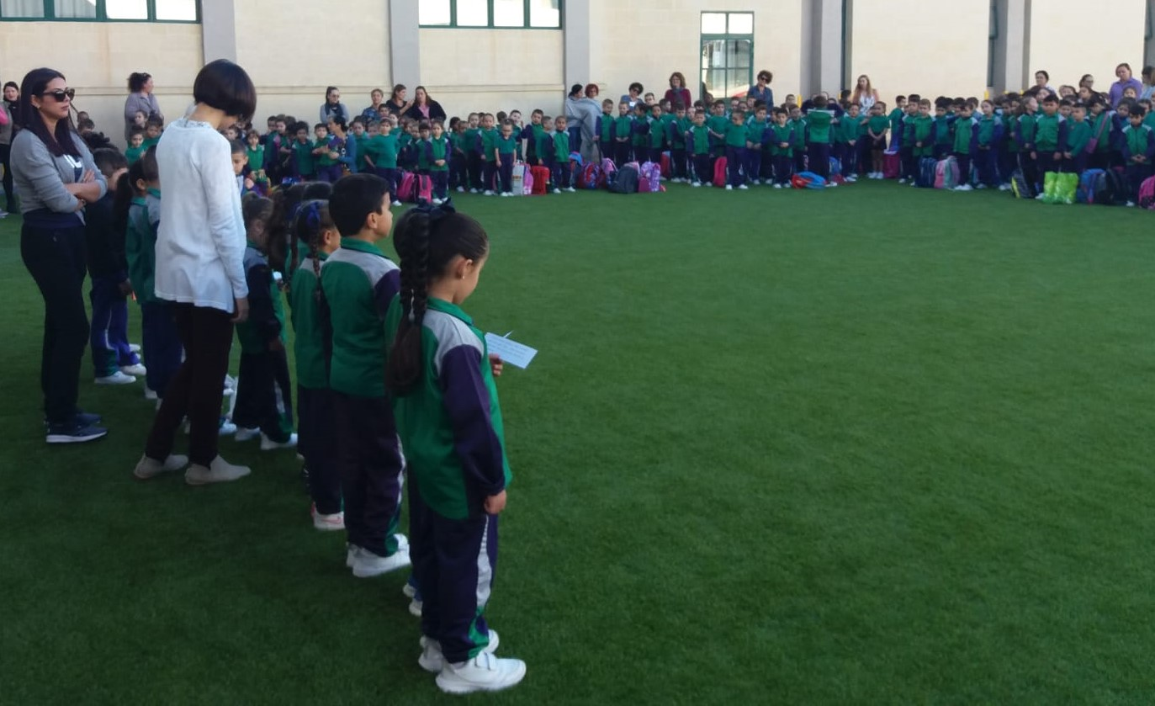
It has a large playground with synthetic turf, a swimming pool and a large hall where we usually do concerts and special assemblies. However, this year we cannot use it because of the pandemic situation ☹.
Swimming Pool
Playground
School Hall

Slide 13

The school hosts approximately 550 pupils between kindergarten and primary classes.

Slide 14

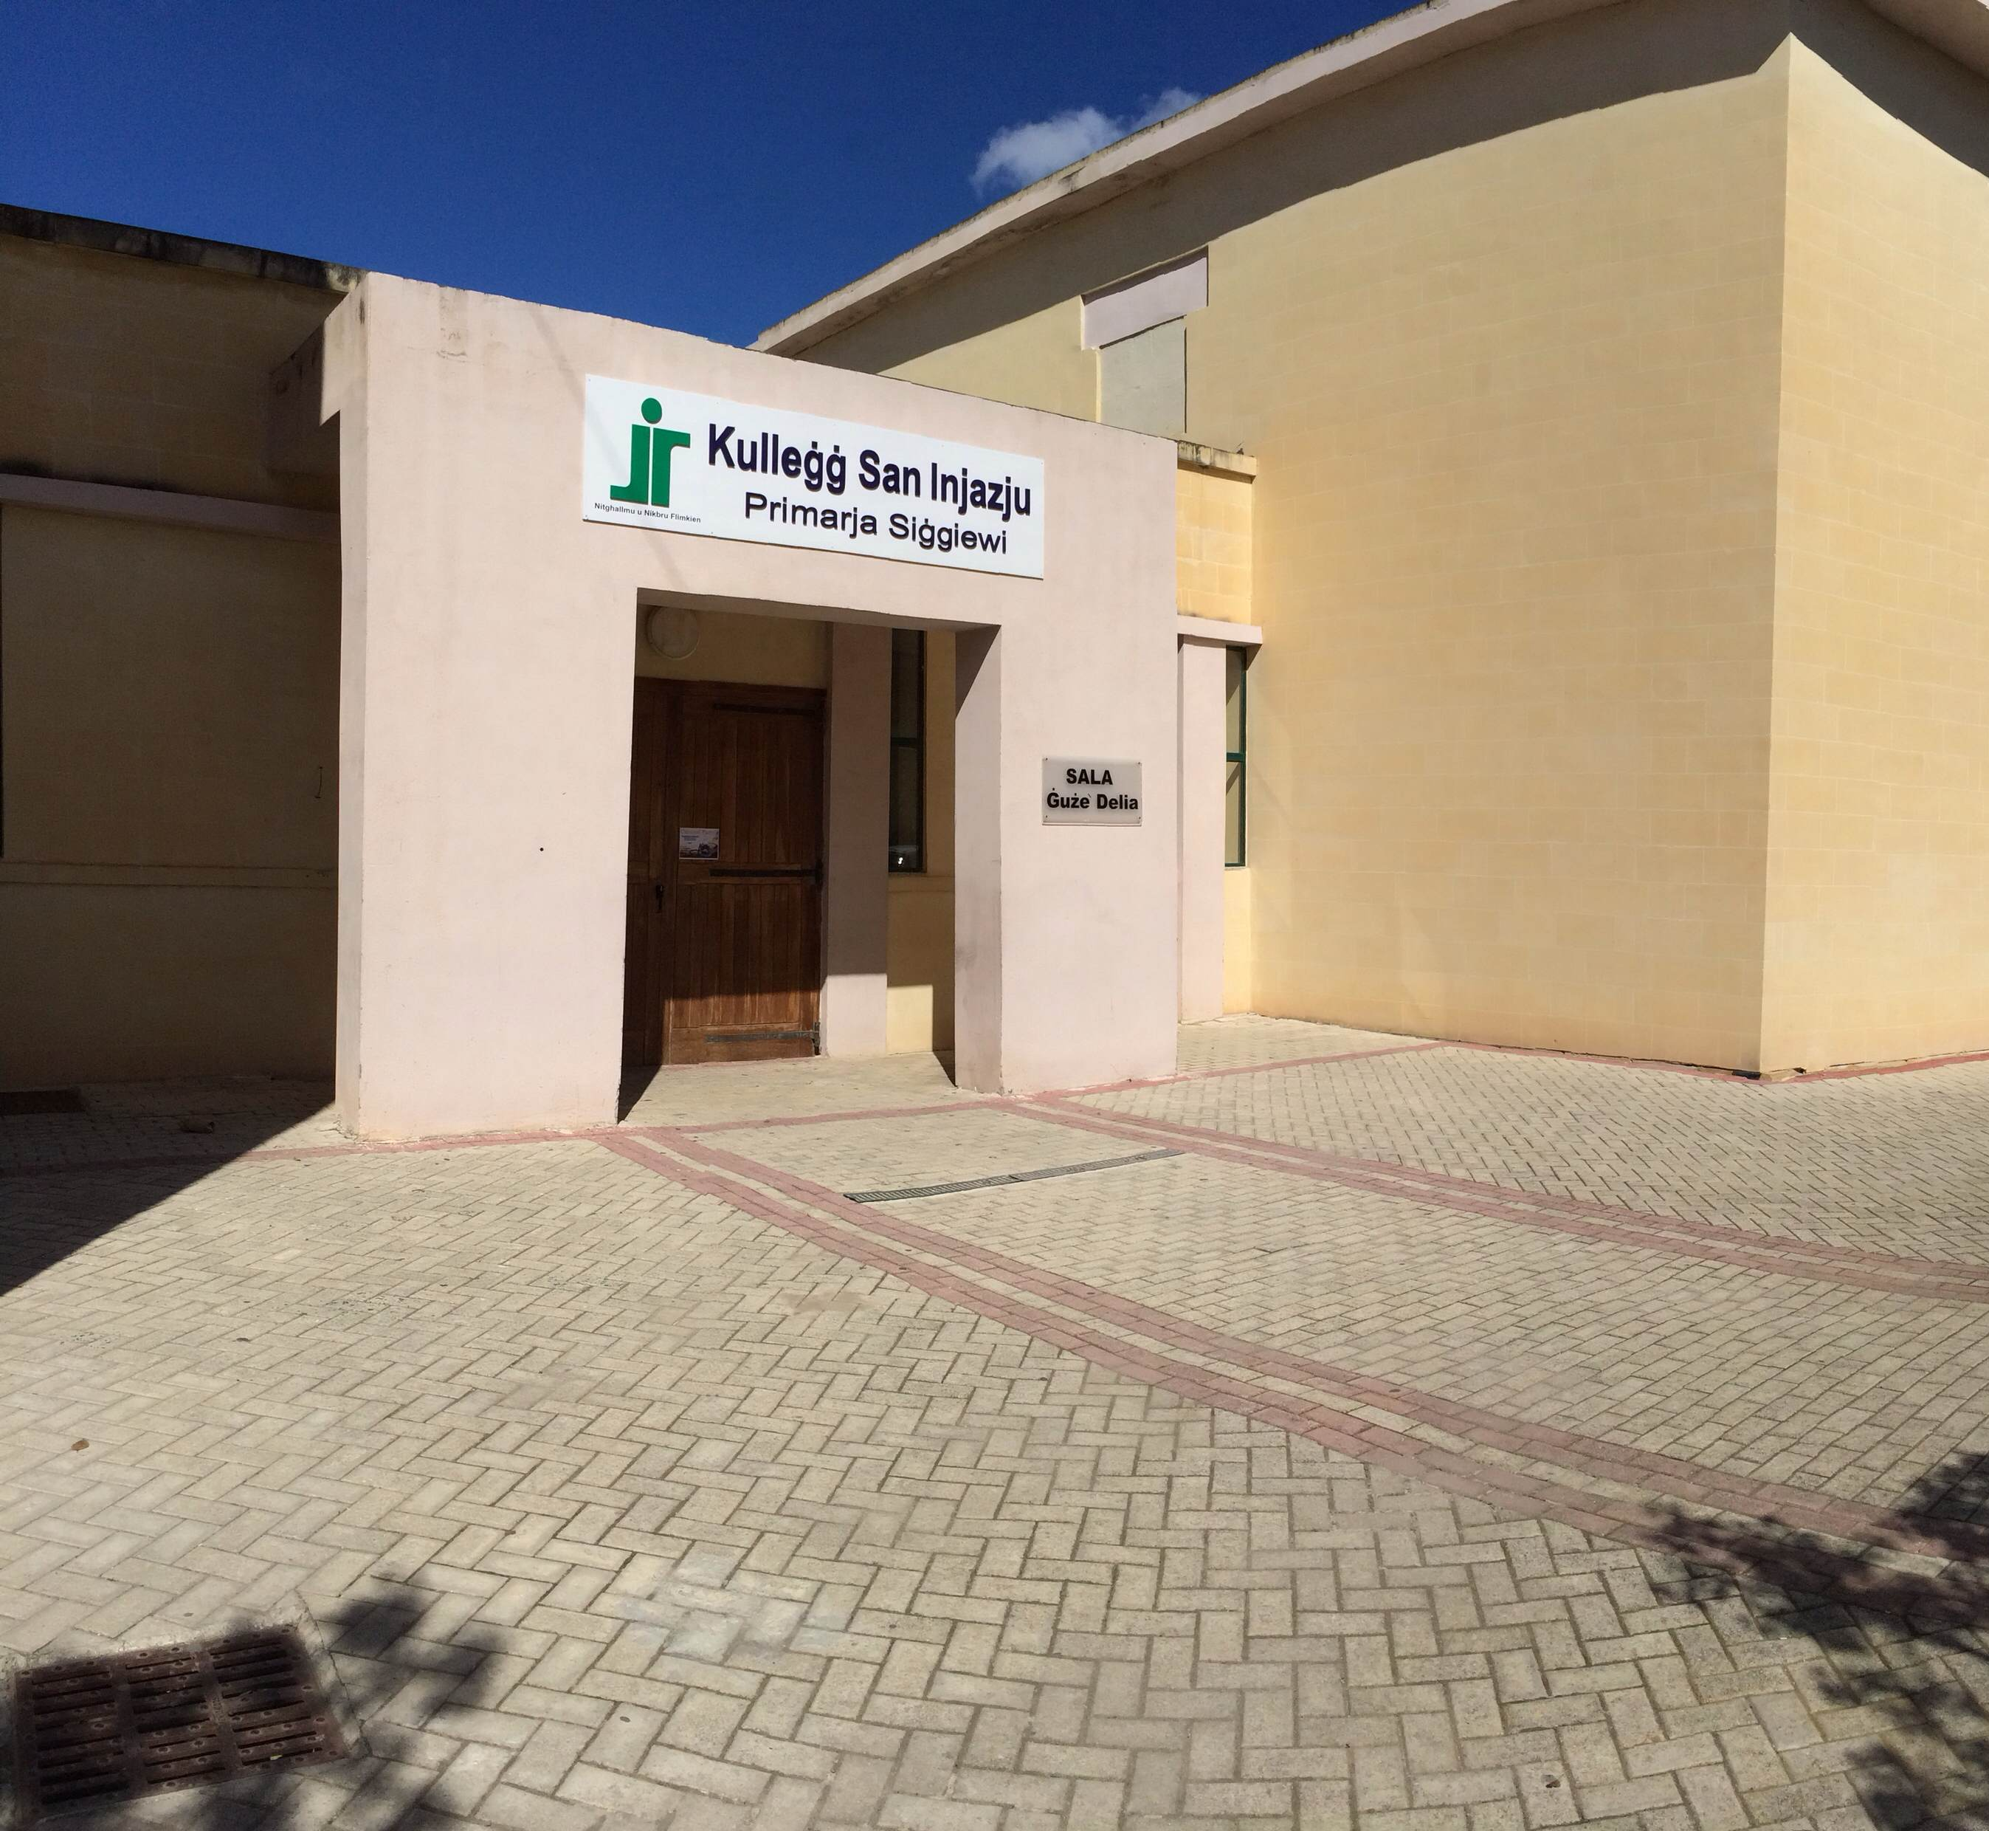
The primary subjects are Maltese, English, Mathematics, Science,
Religion and Social Studies.

Slide 15
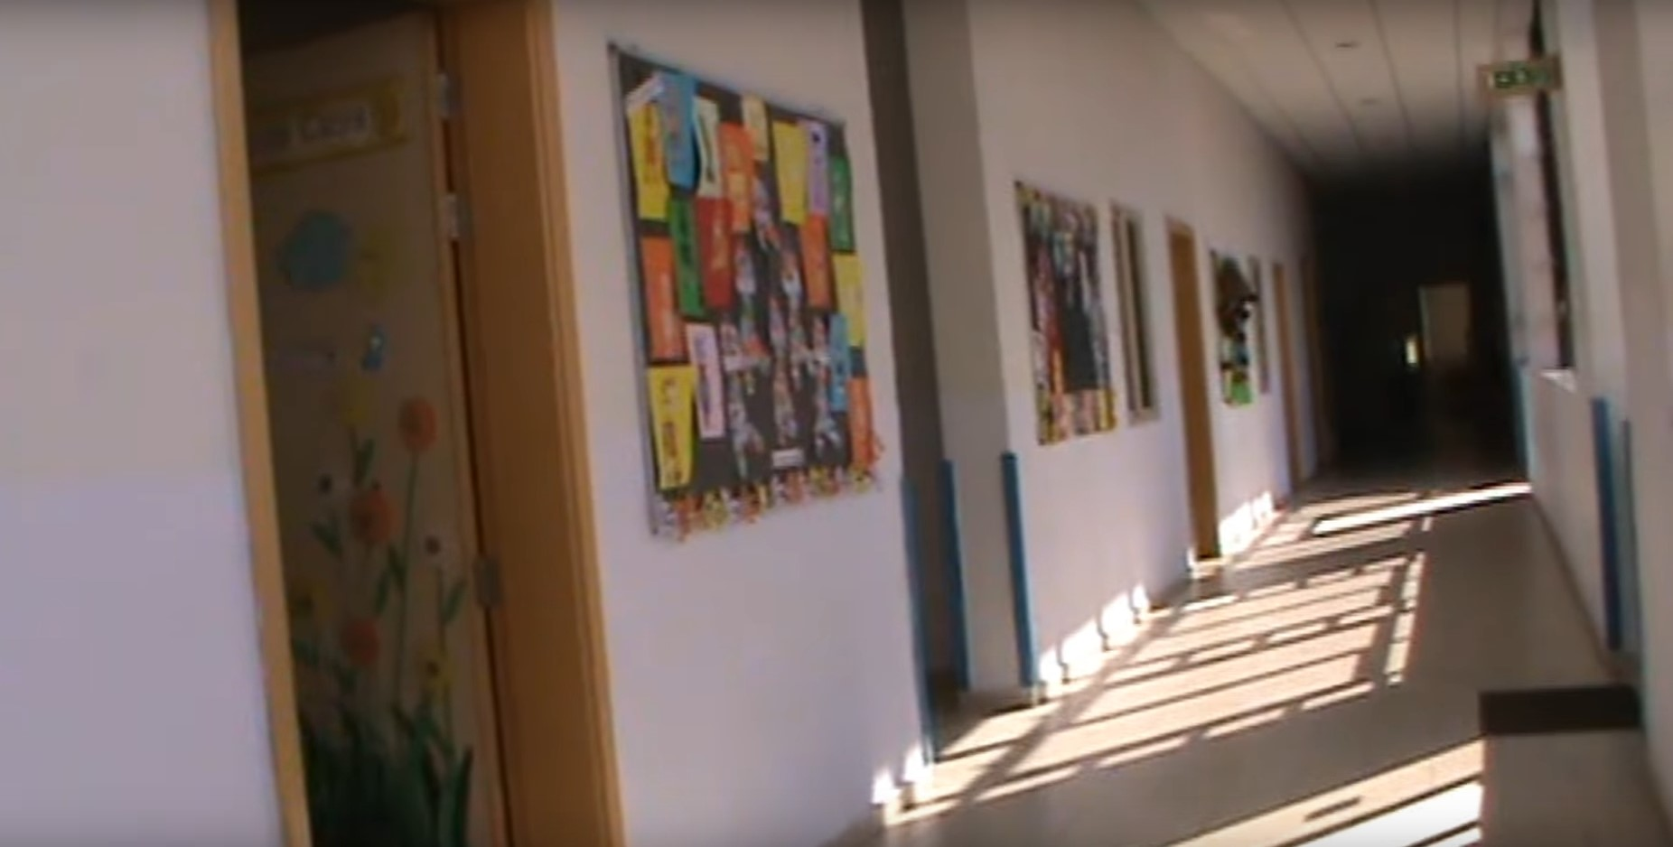
Other subjects are Arts & Crafts, Music, Drama, Information Technology, Physical Education, Personal and Social Development and Thinking Skills.
Other support is given through guidance sessions, complementary education and nurture class.

Slide 16
School profile
Siggiewi primary was previously located in the new building hosting the Local Council and other offices at the village square.
The present school was built as a primary and a girl's secondary school but later it began to host kindergarten and primary pupils.
In the year 2000 the school was name after Patri Guze' Delia, a Maltese poet, and a statue was recently built next to the school hall.

Slide 17
SIĠĠIEWI
Known as Citta’ Ferdinand;
A village in the south part of Malta;
Established on 30th December 1797 by Grandmaster Ferdinand Von Hompesch.

Slide 18
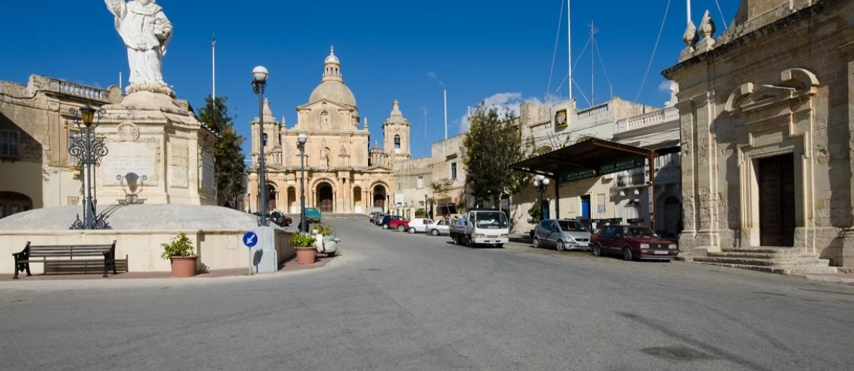
The village square is the heart of Siġġiewi.It is called ‘Pjazza San Nikola.

Slide 19
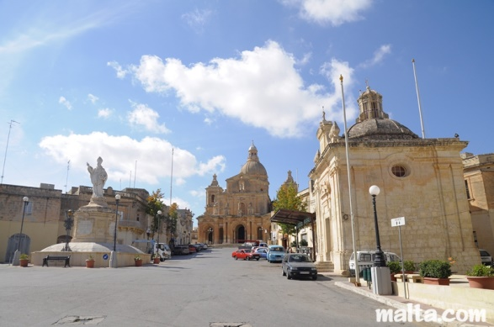
The main square is dominated by the majestic baroque church of St Nicholas at the north end ,a free-standing statue of St Nicholas in the centre and by two smaller chapels on the south side.

Slide 20
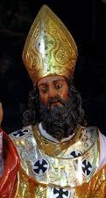
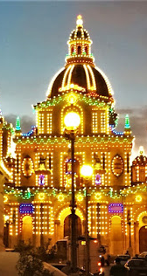
The square is named after Saint Nicholas, the patron saint of Siġġiewi and the parish church is also dedicated to the same saint.
During the last week of June, the square and the church are decorated for the village feast. The square is jam packed with people during the weeklong celebration.

Slide 21
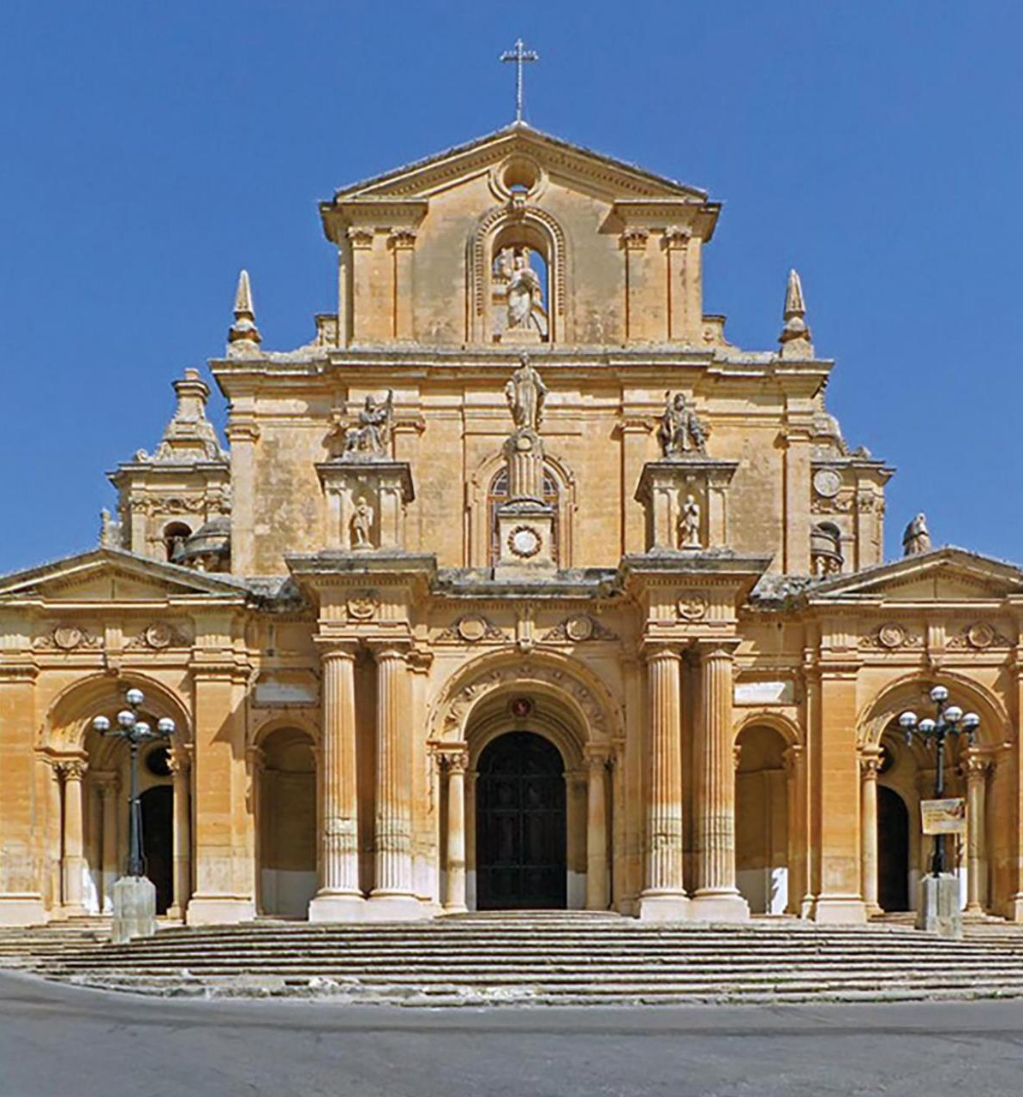
Parish Church
Dedicated to St Nicholas of Bari;
Celebrated on the last Sunday of June every year;
Great Baroque Parish Church constructed between 1676 and 1693;
The church was designed by the Maltese architect Lorenzo Gafa’;
Titular painting by Mattia Preti.

Slide 22
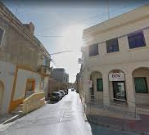
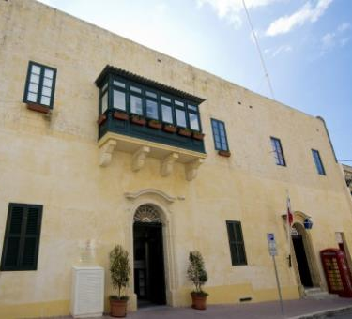
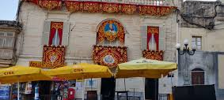
The square hosts important offices and shops. The Local council, the Police Station, 2 commercial banks and band clubs are found in the square. There are also several shops.

Slide 23
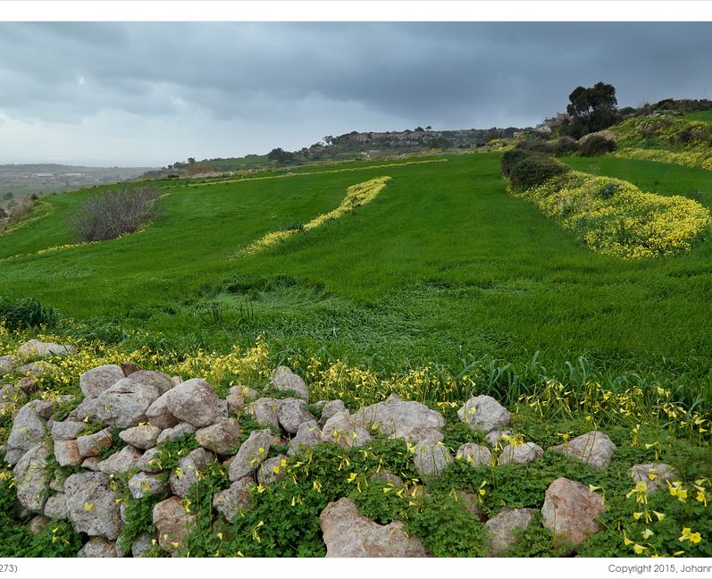
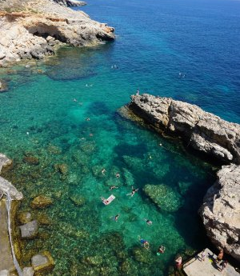
Countryside and beach:
Wied Ħesri
Wied Xkora
Għar Lapsi
Il-Fawwara
Girgenti

Slide 24
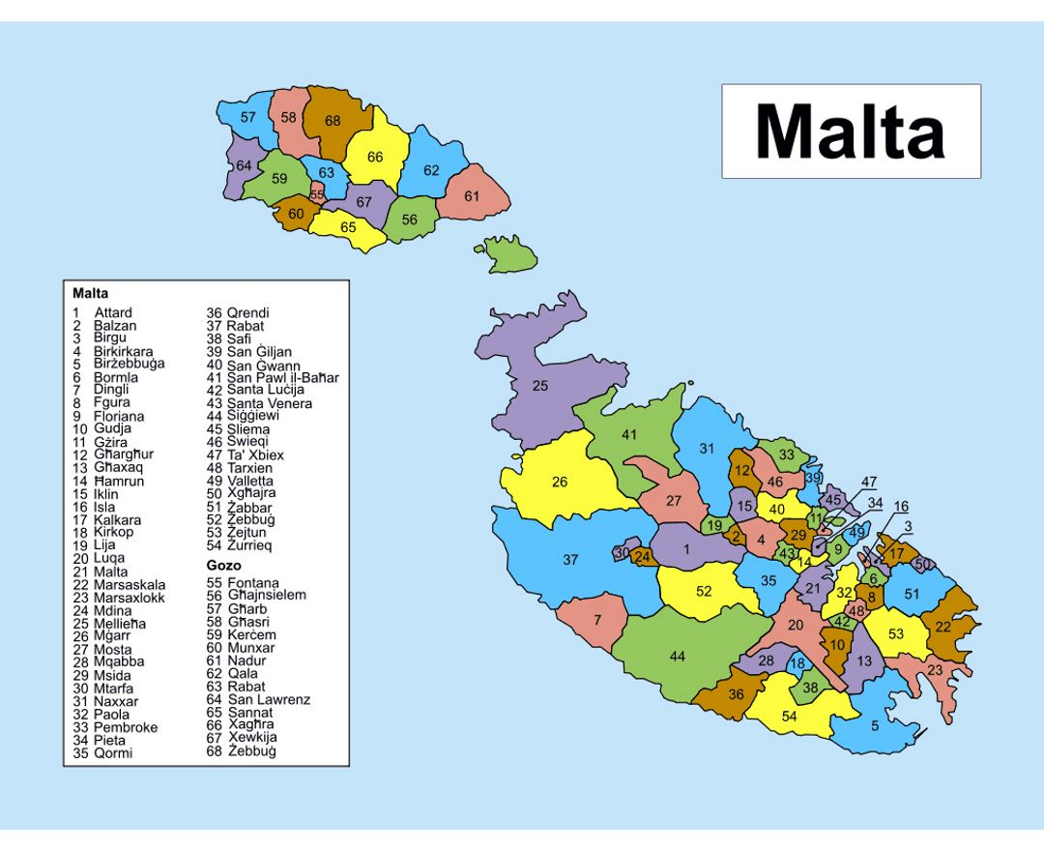
MALTA

Slide 25
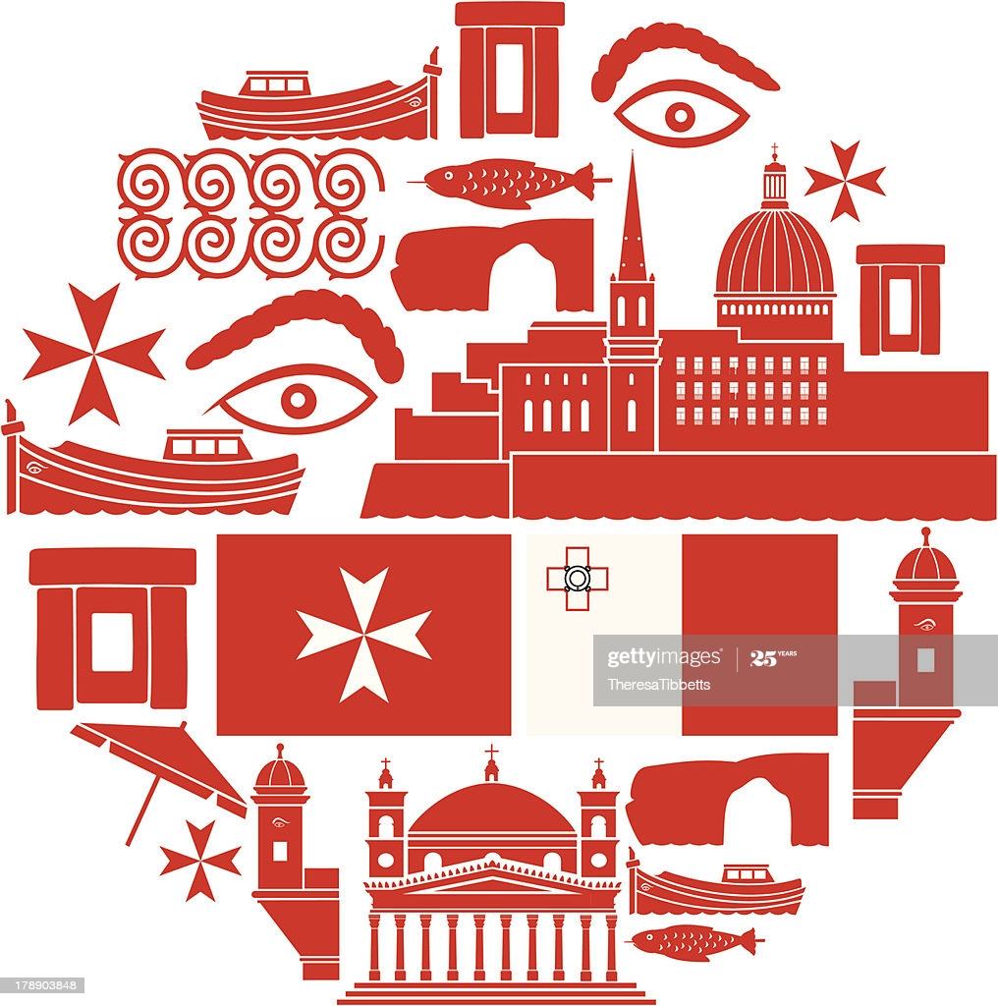

Malta is a southern European island country.
The population in Malta is approximately 550,000 people.
Malta is one of the most densely populated countries in the world. Because of this, it has many cities and towns that grew close to each other over time.
Malta has been inhabited since 5900BC.

Slide 26
Malta is a tourist destination enjoying a warm climate.
It is an archipelago in the center of the Mediterranean sea.
Maltese history is long and colourful, going back thousand of years since prehistoric times.
Christianity was brought to the island around 2000 years ago by St. Paul. His ship was caught is a violent storm and was wrecked on the Maltese coast.

Slide 27

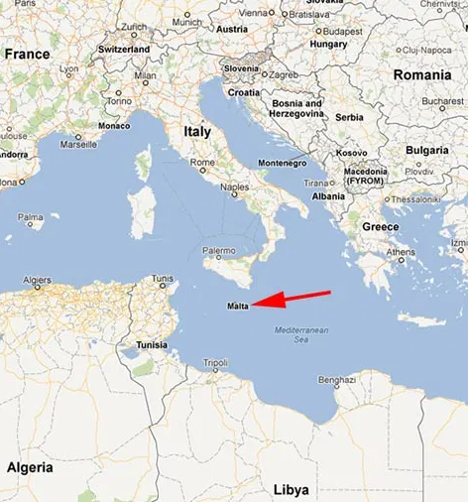
Malta’s Location in the Mediterranean
Malta was occupied by many rulers because of its strategic position in the Mediterranean Sea.
It was ruled by the Phoenicians, the Carthaginians, the Arabs, the Normans, the Aragonese, the Knights of St. John, the French and the British.

Slide 28
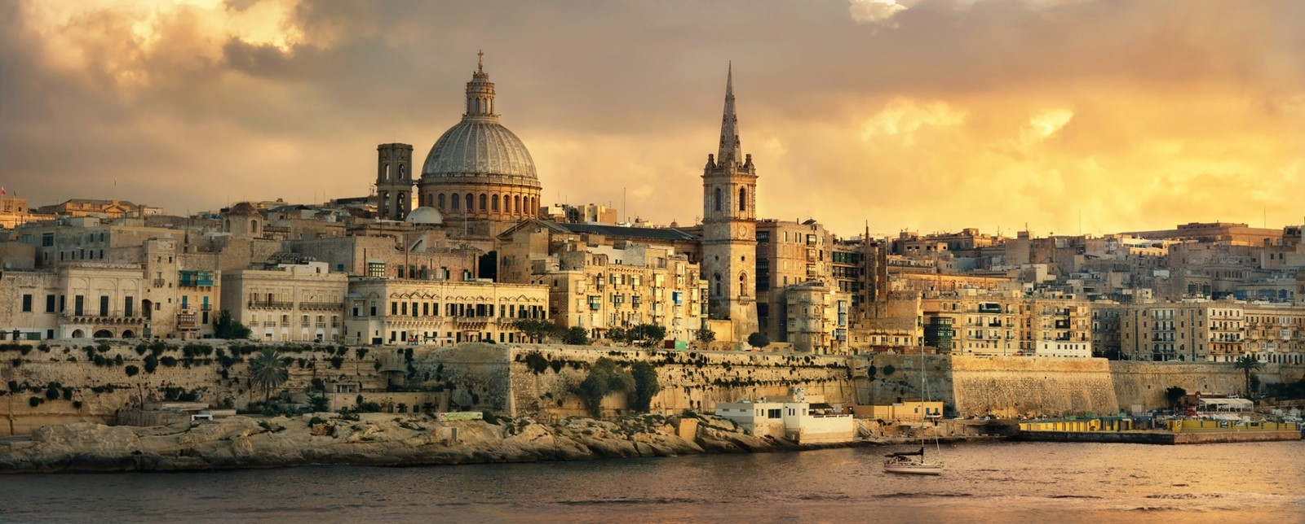
What is the capital city of Malta?
The capital city of Malta is Valletta.
It became Malta’s capital in 1571 when Grand Master Pierre de Monte moved from his seat at Fort St Angelo in Vittoriosa to the Grandmaster's Palace in Valletta.

Slide 29
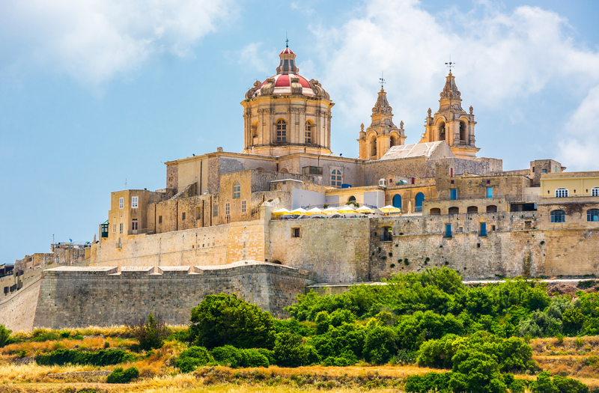
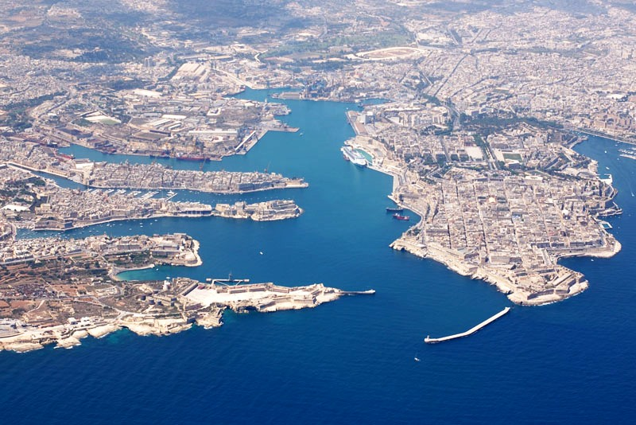
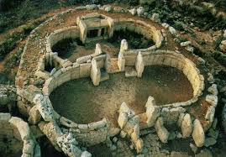
Some places of interest in Malta are the Neolitic Temples, Mdina, The Grand Harbour and The Fortifications.

Slide 30
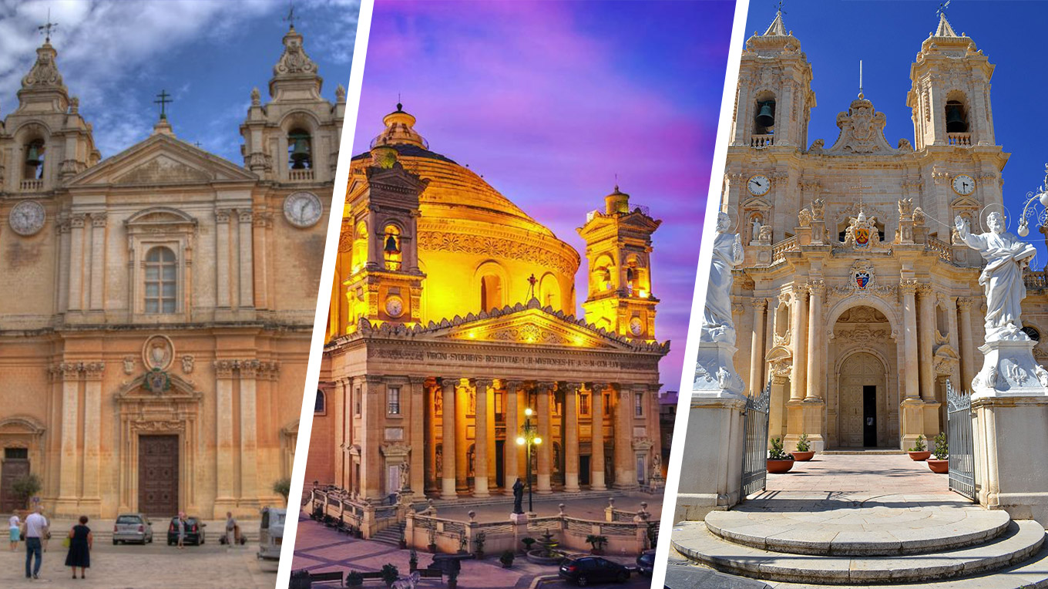
Malta is one of the most Catholic countries in the world. About 98% of the population identifies as Roman Catholic.
Malta is home to 365 churches.

Slide 31
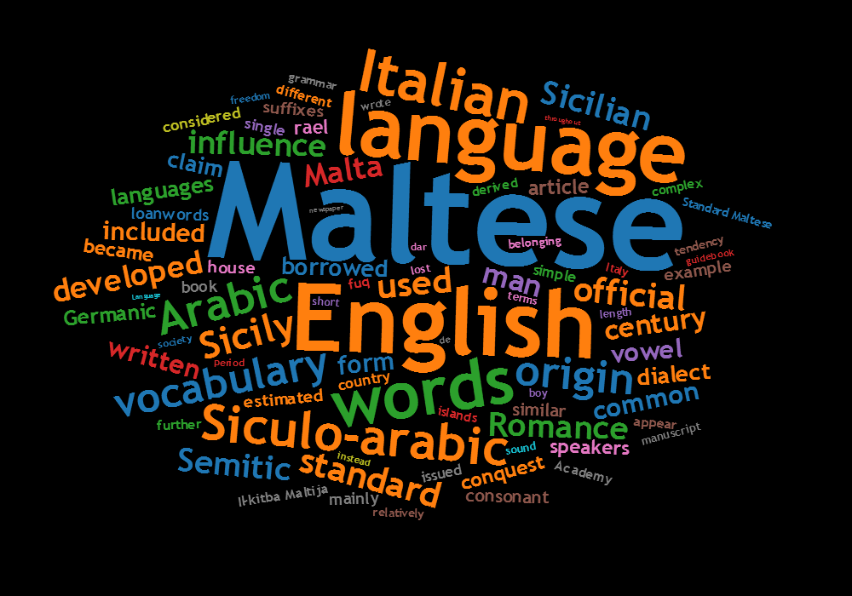
Maltese: A Unique Language
Maltese is a Semitic language spoken by the Maltese people. It is the national language of Malta and also serves as an official language of the European Union.
It has also been deeply influenced by Romance languages namely Italian and Sicilian.
Maltese also includes words coming from the English language.

Slide 32
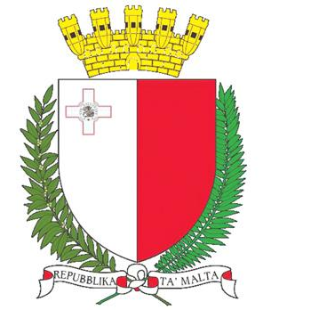
Malta as an
Independent Country
Malta became independent from the United Kingdom in 1964 and became a republic in 1974.
Malta joined the EU on 1st May 2004.

Slide 33
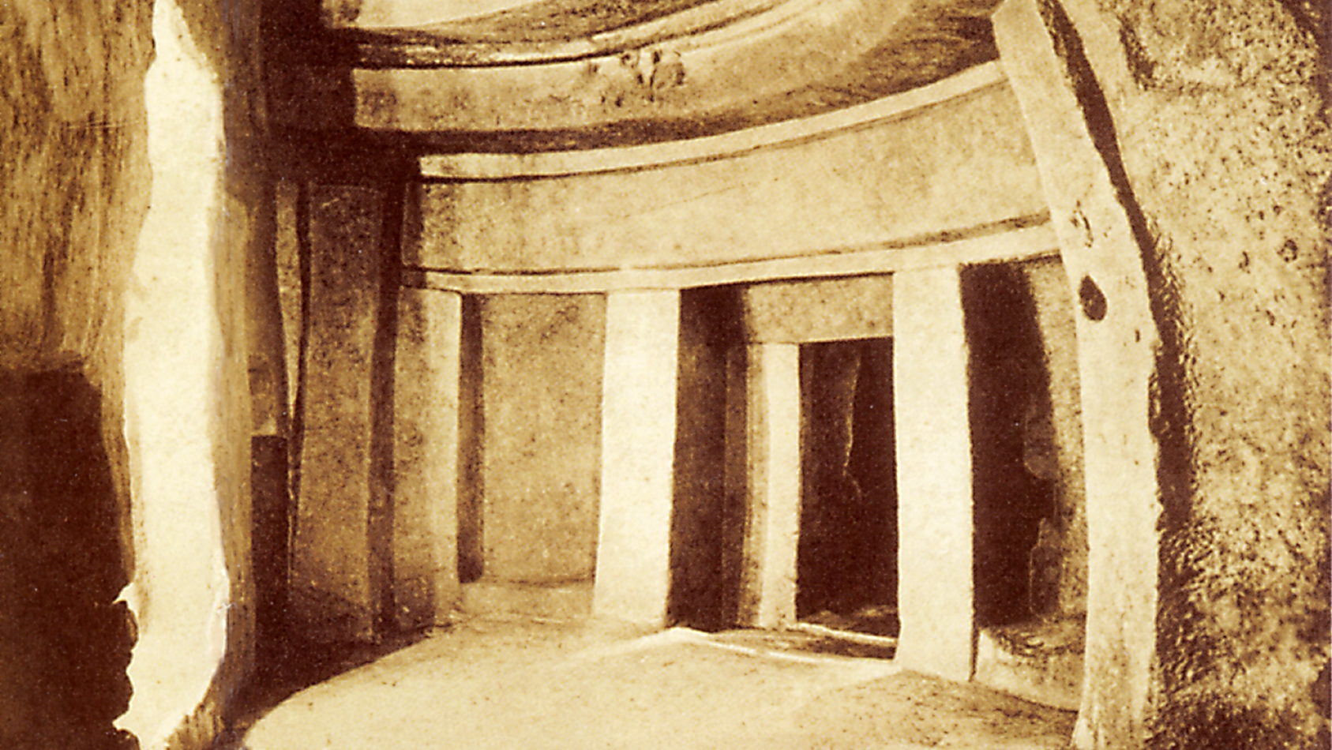
Malta’s Heritage
Malta is a tourist destination with its warm climate, several recreational areas and a rich historical past.
Historical monuments include the Hypogeum of Ħal Saflieni and the megalithic temples which are the oldest structures in the world.

Slide 34

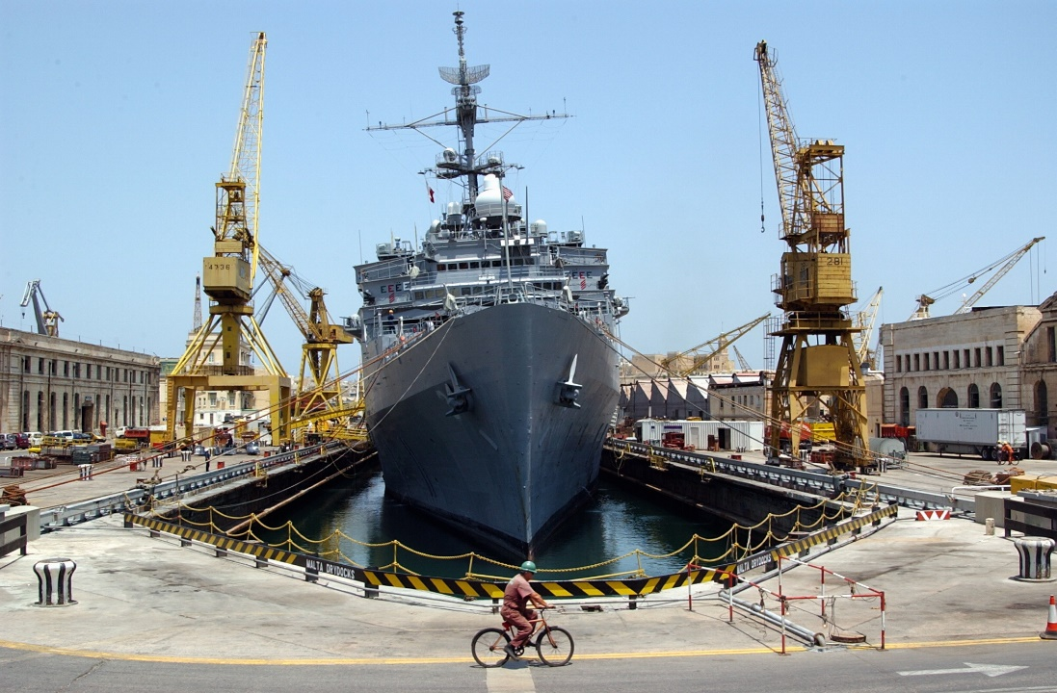
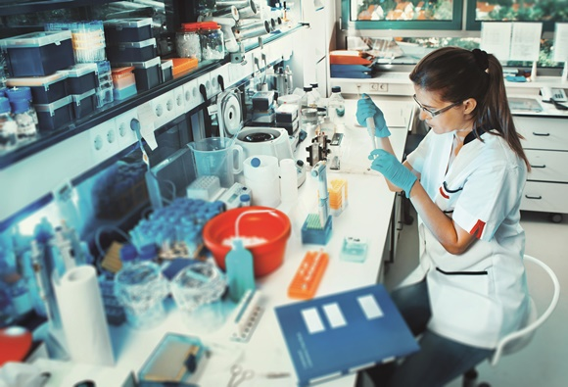
Malta’s major industries are tourism, electronics, pharmaceutical, shipbuliding and repair, construction and textiles.

Slide 35
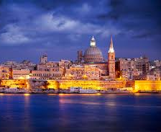
Malta attracts lots of tourists to visit especially in the summer months because of our beautiful sea. We have lots of cultural places to visit and one can visit our sister island Gozo which is part of the Maltese Archipelago.

Slide 36
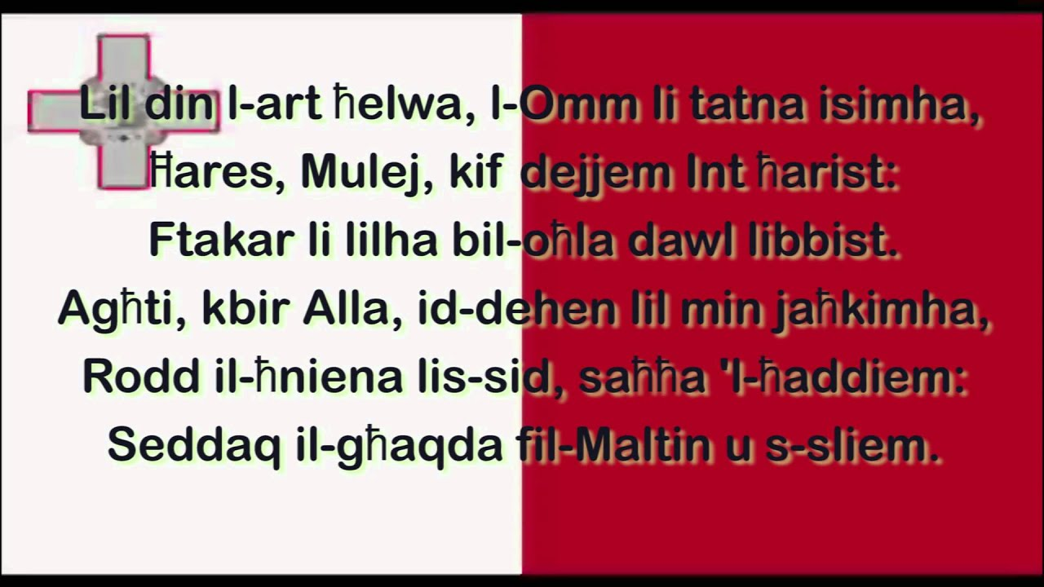

Maltese National Anthem
https://www.youtube.com/watch?v=sD2Mjp9n0kI

Slide 37

Thank you! ☺

